Slide 1
A Hierarchical Splitting Scheme to Reveal Insight into Highly Self-Occluded Integral Surfaces
Andrea Brambilla
Ivan Viola
Helwig Hauser
University of Bergen
www.ii.uib.no/vis

Slide 2
Flow Phenomena and Visualization
Wikipedia
Notes:
This work is about flow visualization
The goal is to convey flow behaviour using visual entities
Intersting aspects of flow phenomena → analysis of particles motion within the flow

Slide 3
Raw Data
Wikipedia
Notes:
Flow attributes smpled at specific spatial locations

Slide 4
Flow Features
Wikipedia
Vortex
Saddle

Slide 5
Integral Structures
Wikipedia
Notes:
Usually performed using the so called „integral structures“
For example: one seed point → integral curve which depict a particle‘s trajectory
While seeding along a line produces an integral surface

Slide 6
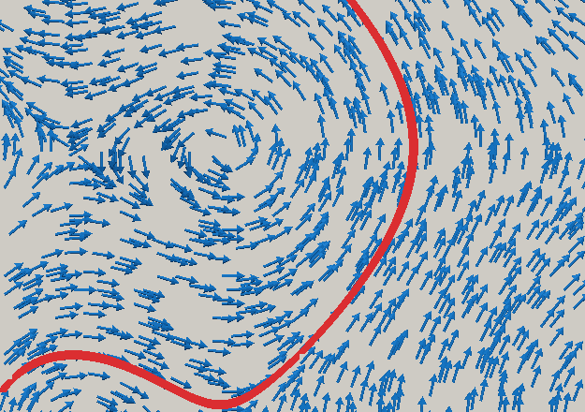
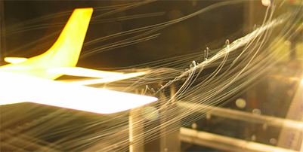
Integral Structures
Streamline
Streak lines
Path line
Wikipedia
Time line
Wikipedia
Notes:
Overview of the integral structures we will meet during this presentation

Slide 7
Integral Structures
Streamline
Stream surface
Streak lines
Path line
Path surface
Wikipedia
Time line
Time surface
Wikipedia
Notes:
Focus on streamline and path lines

Slide 8
Integral Structures
Streamline
Stream surface
Streak lines
Path line
Path surface
Wikipedia
Time line
Time surface
Wikipedia
Notes:
Focus on stream and path surfaces
Stream and path surfaces have many common properties
They are the same for steady flows
We focus on streamsurfaces, knowing that extension to pathsurfaces is straightforward

Slide 9
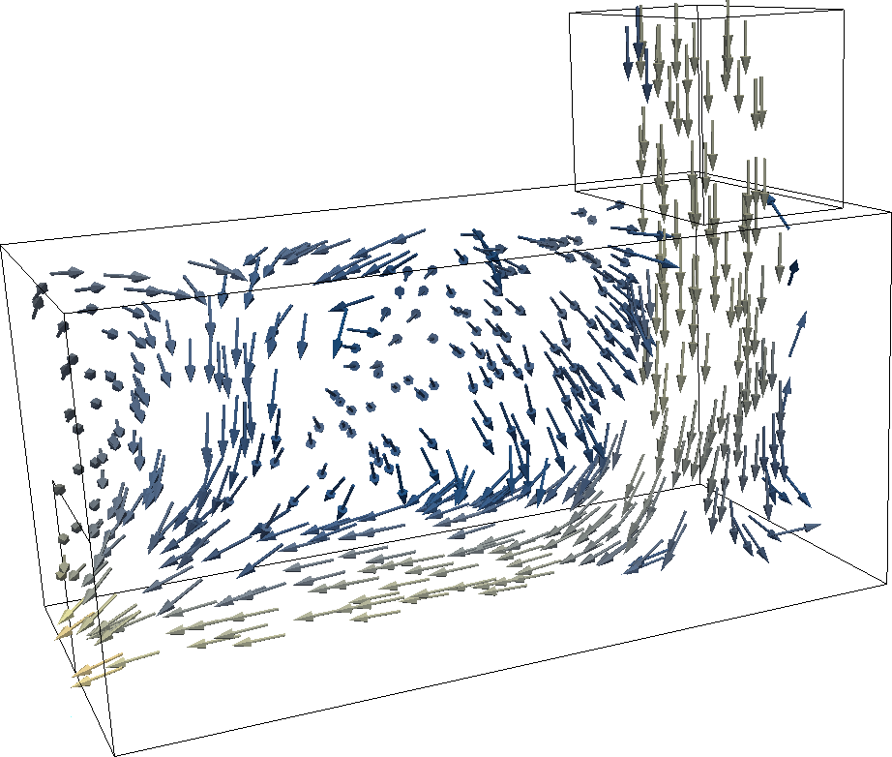
Integral Surfaces
Notes:
Simple example of fluid flow

Slide 10
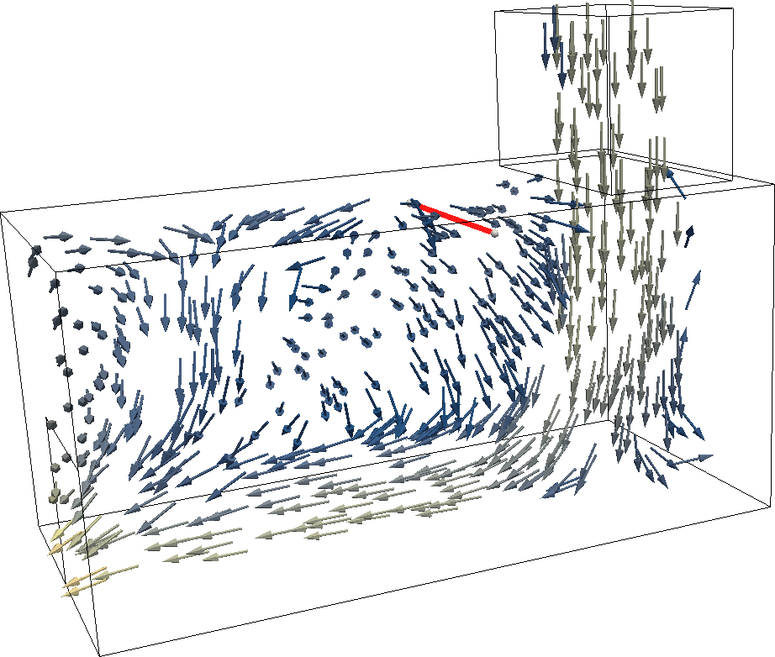
Integral Surfaces
Notes:
As an example, place a seeding line...

Slide 11
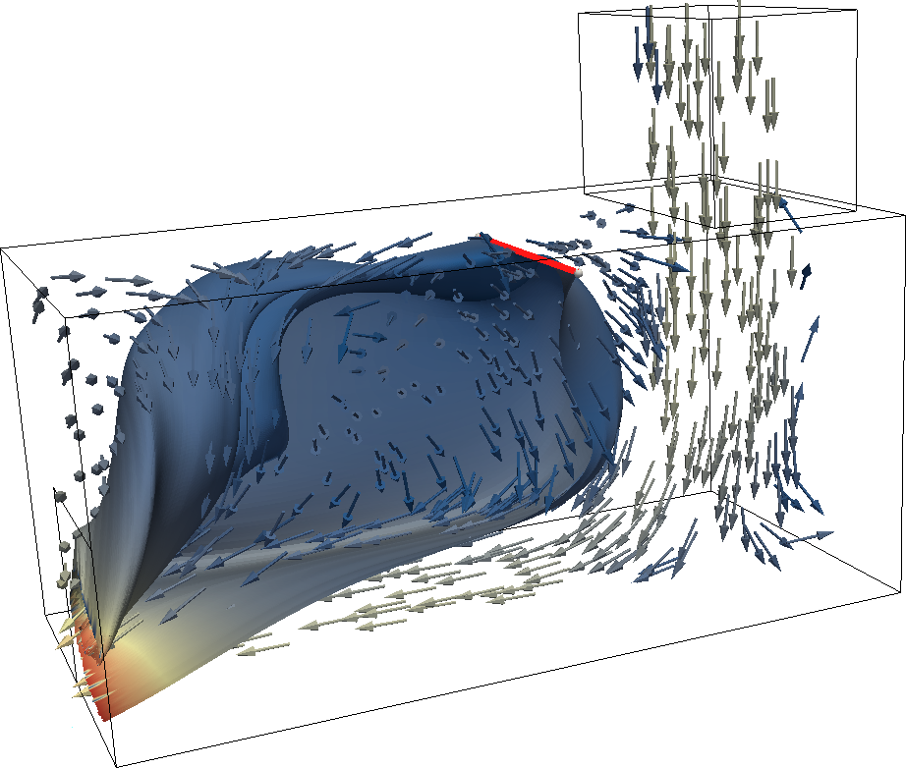
Integral Surfaces
Notes:
... and generate the related stream surface

Slide 12
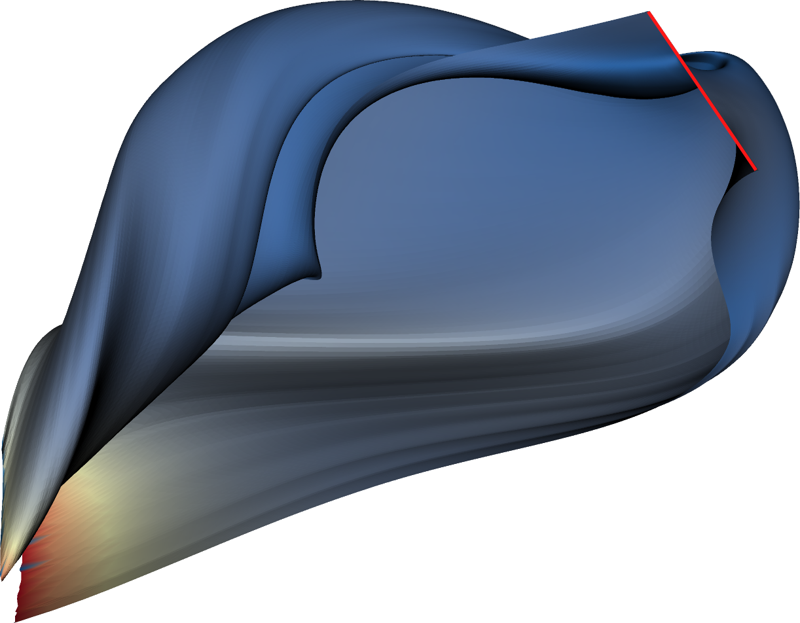
Cluttering & Self Occlusion
Notes:
The generated surface is not easy to understand and there is a lot of cluttering especially in correspondence of the swirling area of the flow
The surface is colored according to the magnitude of the velocity

Slide 13
Surface Splitting
Notes:
What we do to solve this issue, we take the surface...

Slide 14
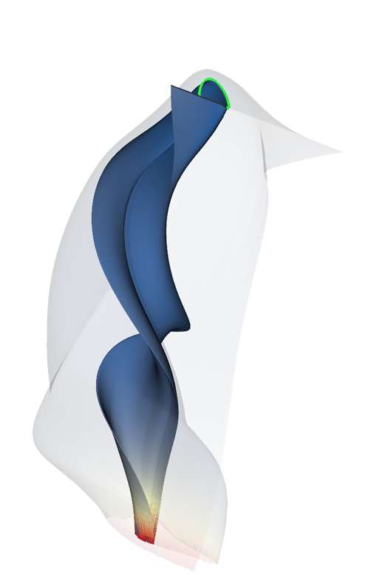
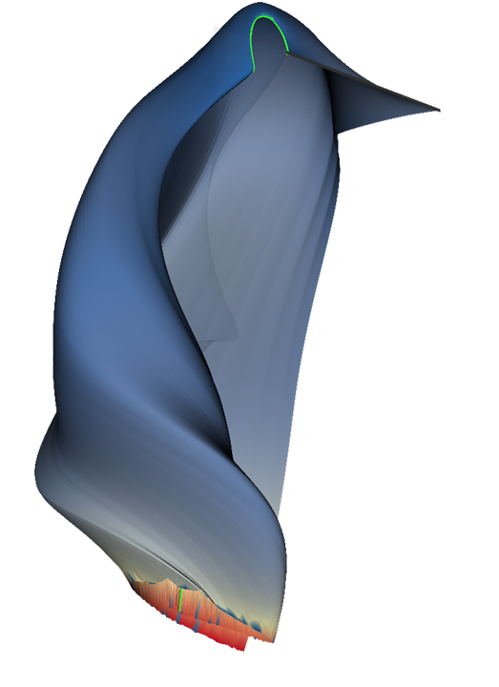
Surface Splitting
Notes:
... and we cut it open in order to see what‘s going on inside

Slide 15
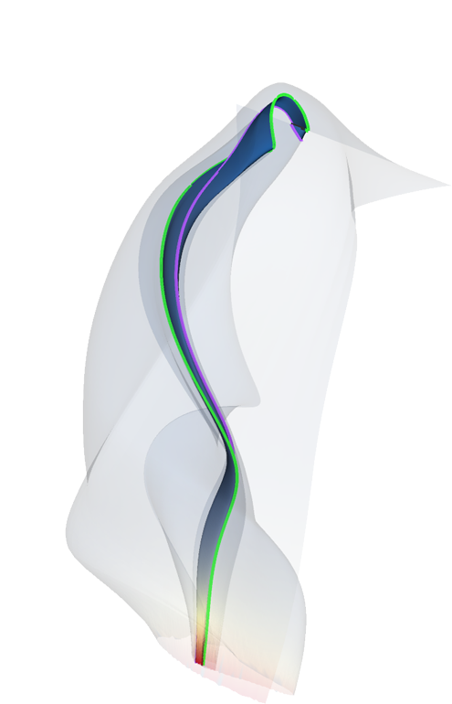
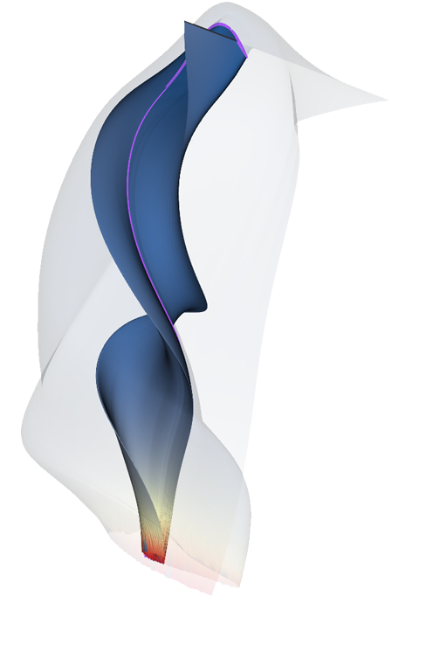
Surface Splitting
Notes:
The single pieces can be inestigated on their own
The rest of the surface can be displayed semi-transparent to provide contextual information
The cuts are not random but made according to a precise schema that I am going to explain

Slide 16
A Generic Splitting Framework
Visualization and User Interaction
Surface
Pieces
Importance
Cut Space
Complexity Measure
Cut Selection and Splitting
Notes:
How did we do it:
We thought of what are the requirements of an effective splitting algorithm
This lead to the design a generic framework
Later used then to develop our splitting approach for integral surfaces

Slide 17
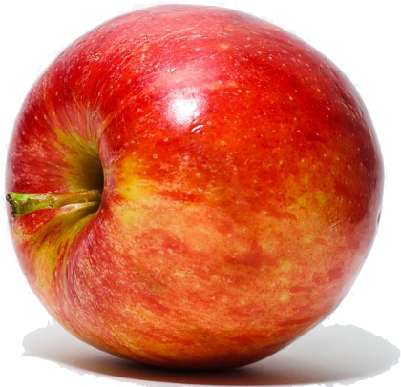
A Generic Splitting Framework
Visualization and User Interaction
Surface
Pieces
Importance
Cut Space
Complexity Measure
Cut Selection and Splitting
Notes:
... he can request a cut.

Slide 18
A Generic Splitting Framework
Visualization and User Interaction
CUT!
Surface
Pieces
Importance
Cut Space
Complexity Measure
Cut Selection and Splitting
Notes:
... he can request a cut.

Slide 19
A Generic Splitting Framework
Visualization and User Interaction
Surface
Pieces
Importance
Cut Space
Complexity Measure
Cut Selection and Splitting
Notes:
Then 2 steps are performed: generation of the cut space and computation of the complexity measure

Slide 20
A Generic Splitting Framework
Visualization and User Interaction
Surface
Pieces
Importance
Cut Space
Complexity Measure
Cut Selection and Splitting
Notes:
The cut space is the set of all the possible ways to cut the surface

Slide 21
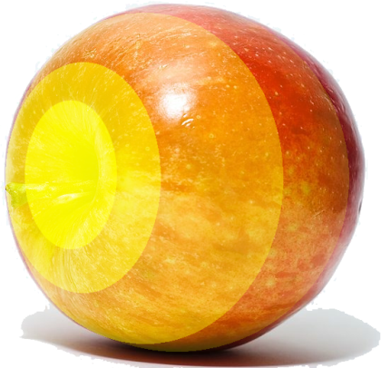
A Generic Splitting Framework
Visualization and User Interaction
Surface
Pieces
Importance
Cut Space
Complexity Measure
Cut Selection and Splitting
Notes:
A complexity measure is computed over the surface and it will be later used to define how to cut split it.
It can optionally take into account the difference between more and less important parts of the surface

Slide 22
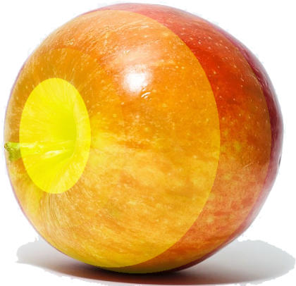
A Generic Splitting Framework
Visualization and User Interaction
Surface
Pieces
Importance
Cut Space
Complexity Measure
Cut Selection and Splitting
Notes:
At the end the cut from the cut space which reduce complexity the most is chosen

Slide 23
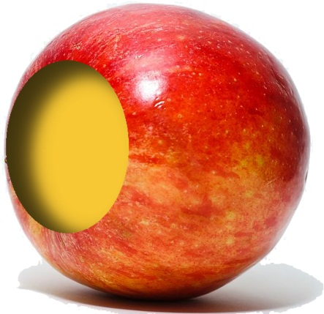
A Generic Splitting Framework
Visualization and User Interaction
Surface
Pieces
Importance
Cut Space
Complexity Measure
Cut Selection and Splitting
Notes:
The surface is split according to it and finally we go back to show the result at the user, which can ask to generate other cuts

Slide 24
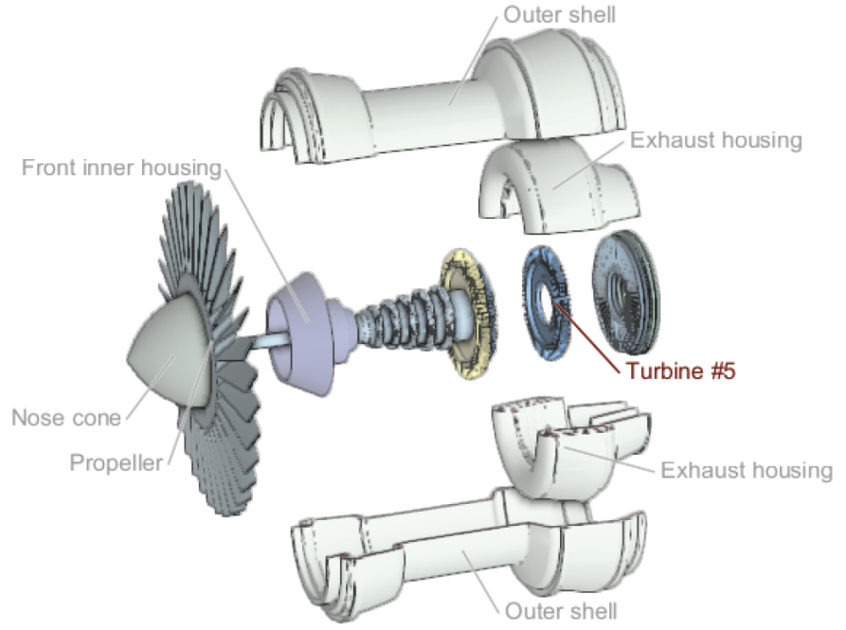
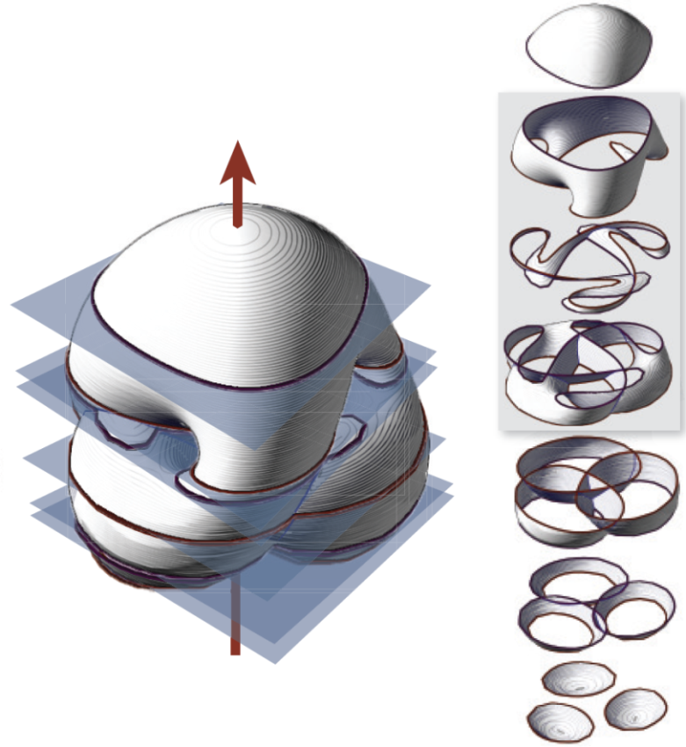
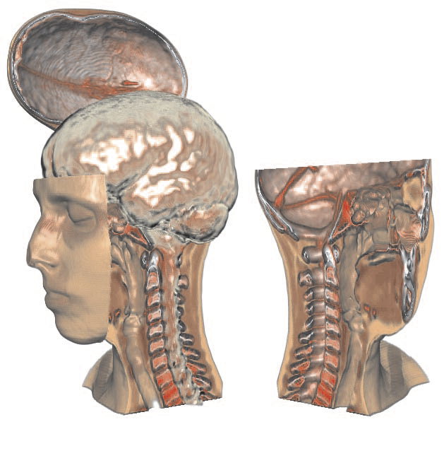
Existing Approaches
Karpenko et al. 08:
- parallel planes
- symmetries
Li et al. 08:
- building blocks
- blocks relationships
Bruckner and Gröller 06:
- user defined cuts
- view dep. occlusion
Notes:
Existing approaches can be easily mapped to our framework
First line of every entry is the cut space
Second line is the complexity measure

Slide 25
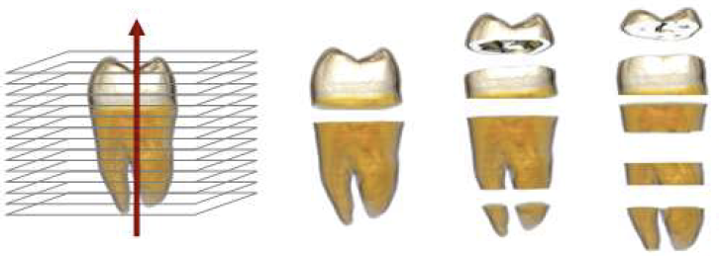
Existing Approaches
Karpenko et al. 08:
- parallel planes
- symmetries
Li et al. 08:
- building blocks
- blocks relationships
Bruckner et al. 06:
- user defined cuts
- view dep. occlusion
Ruiz et al. 08: parallel planes - information theory
Notes:
Existing approaches can be easily mapped to our framework
First line of every entry is the cut space
Second line is the complexity measure

Slide 26
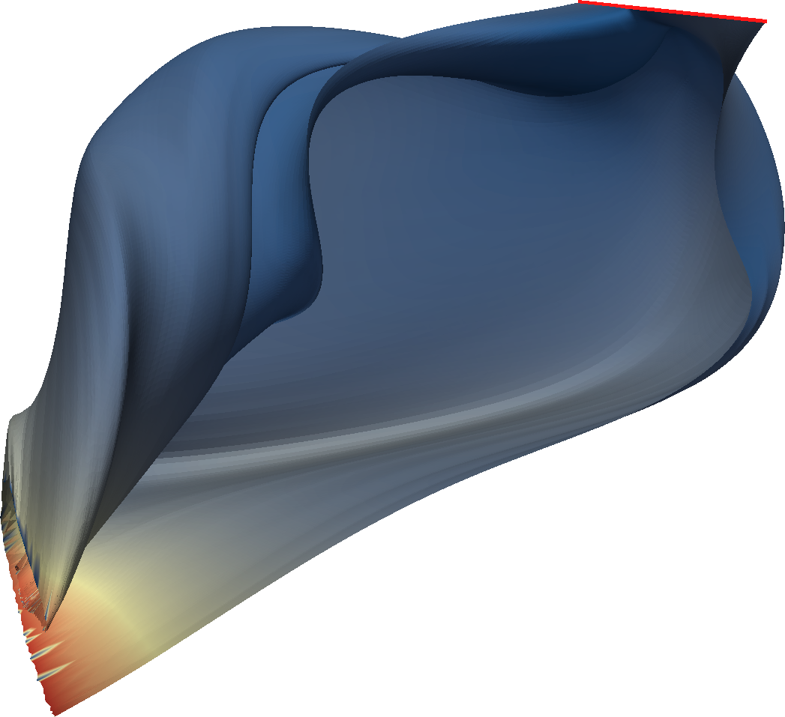
Cut Space: Surface Parameterization
No building blocks
Notes:
Why these approaches cannot be used for integral surfaces

Slide 27
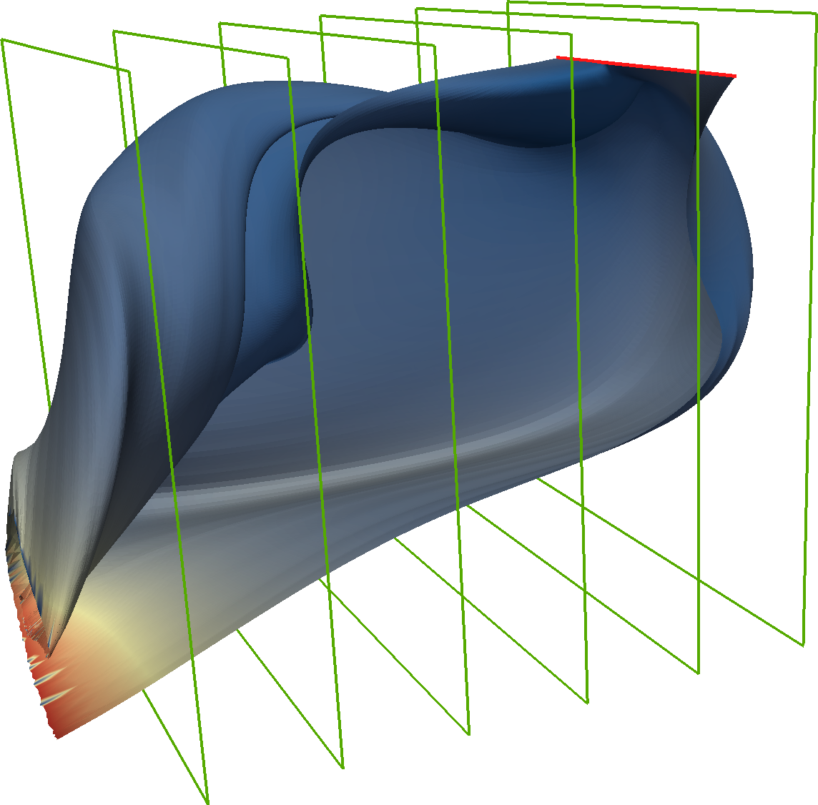
Cut Space: Surface Parameterization
No building blocks
Arbitrary cuts not effective

Slide 28
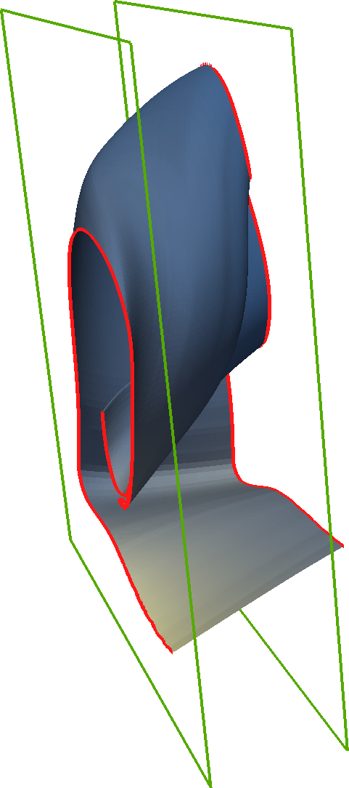
Cut Space: Surface Parameterization
No building blocks
Arbitrary cuts not effective

Slide 29
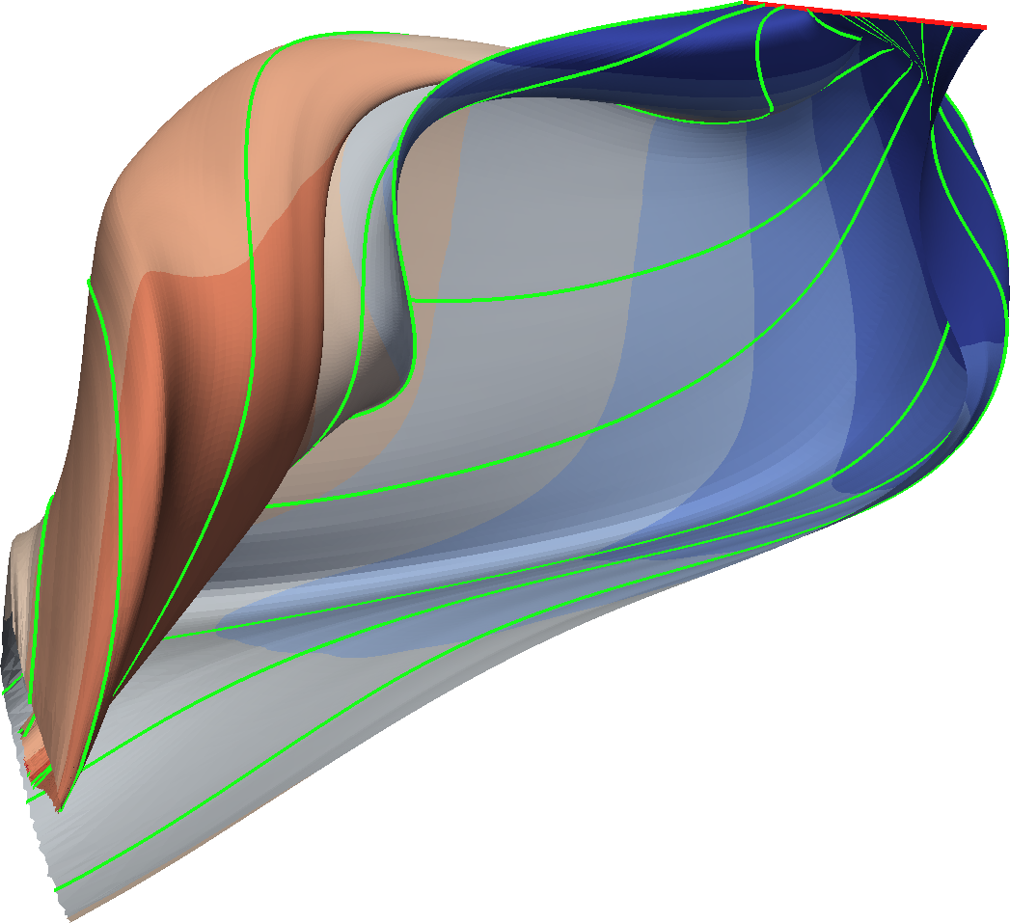
Cut Space: Surface Parameterization
No building blocks
Arbitrary cuts not effective
(s_{p,} 0)
Parameterization
seeding point
integration time
Cut space given by
stream / path lines
time lines
(s_{p,} t_{p})

Slide 30
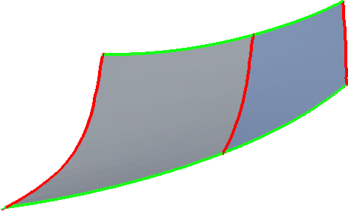
Cut Space: Surface Parameterization
No building blocks
Arbitrary cuts not effective
Parameterization
seeding point
integration time
Cut space given by
stream / path lines
time lines
Preserve surface semantic

Slide 31
Surface Complexity
How much a point «occludes» the rest of the surface
Visualization tools typically employ polar view
p₂
p₁
pivot
Notes:
Polar view → camera moving circularly around a pivoting point placed at the center of the object
We approximately quantify the amount of occlusion of a point when it lies between the camera and the pivot

Slide 32
Surface Complexity
How much a point «occludes» the rest of the surface
Visualization tools typically employ polar view
p₂
For every point p
cpx(p) = | X |
X₂
p₁
pivot
X₁
cpx(p₁) = 3 cpx(p₂) = 2
Notes:
The complexity of a point p is the number of intersection points between the surface and the ray that goes from p to the pivot

Slide 33
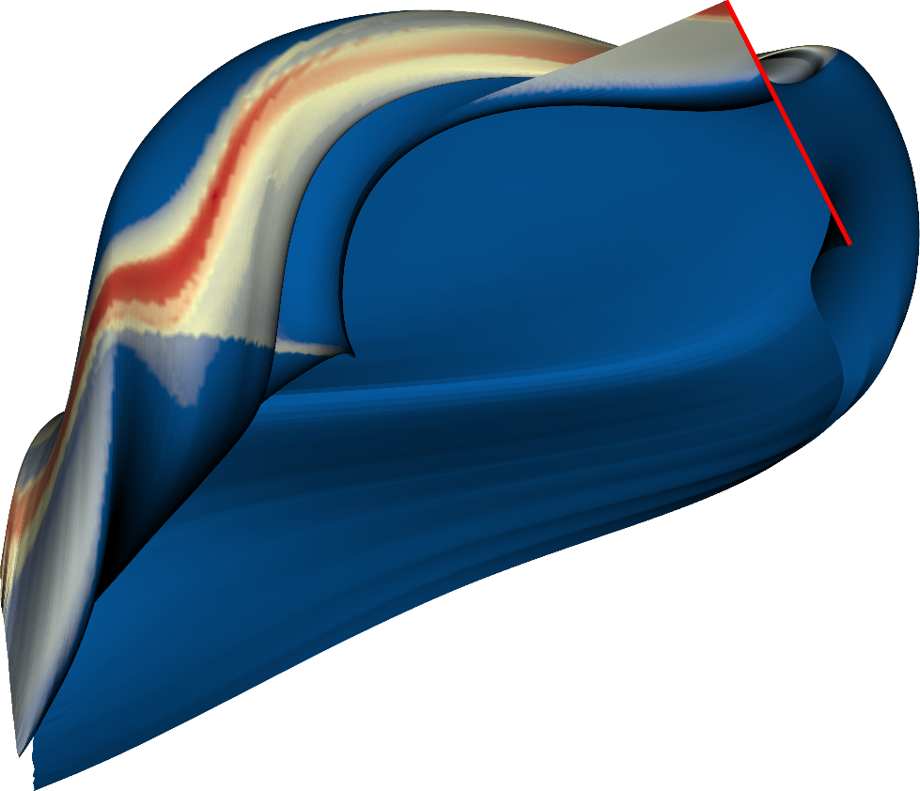
Surface Complexity
Notes:
Complexity values computed on the example surface
The points of highest complexity are on the outer part of the twisting area of the surface

Slide 34
Surface Complexity
How much a point «occludes» the rest of the surface
Visualization tools typically employ polar view
p₂
For every point p
cpx(p) = | X |
X₂
Including the importance
p₁
pivot
X₁
cpx(p) =
= ∑_{x∈X}importance(x)
cpx(p₁) = 3 cpx(p₂) = 2
Notes:
If areas of the surface has diffent importane levels, this can be easily integrated in the proposed complexity measure

Slide 35
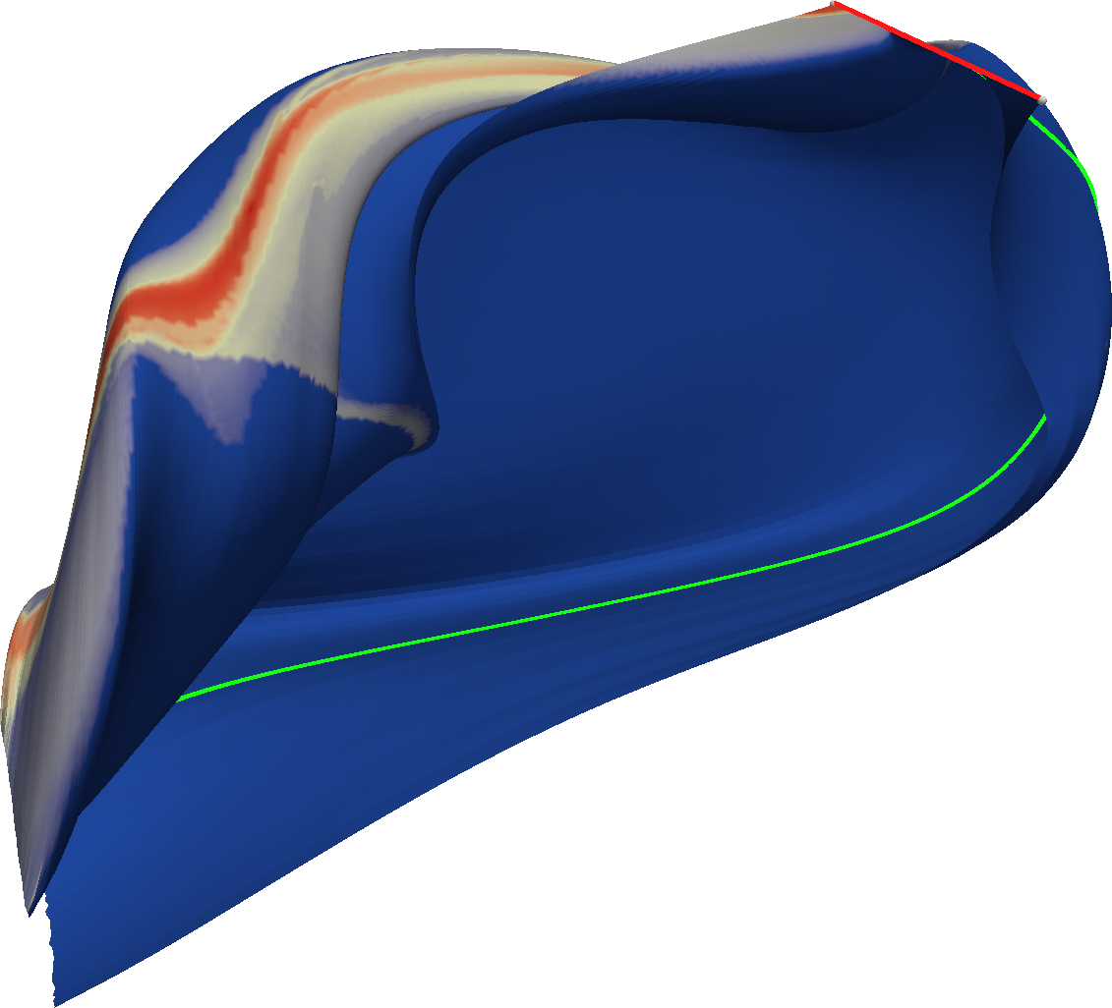
Cut Selection and Splitting
Choose the cut Ω that reduce occlusion the most
Notes:
We must choose the cut that reduce complexity the most
The complexity has already been computed for every point of the surface
We compute the overall complexity of a cut averaging the complexity along the cut itself
We choose the cut with the highest overall complexity and cut the surface along it

Slide 36
Cut Selection and Splitting
Choose the cut Ω that reduce occlusion the most
p₁
p₂
p₃
p₄
p₅
p₆
p₇
p₈
p₉
CPX(Ω) = length(Ω)⁻¹ ∙ ∫_{Ω}cpx(p)dp
Notes:
We must choose the cut that reduce complexity the most
The complexity has already been computed for every point of the surface
We compute the overall complexity of a cut averaging the complexity along the cut itself

Slide 37
Cut Selection and Splitting
Choose the cut Ω that reduce occlusion the most
Complexity already computed for every point p
Average complexity over potential cuts
The cut with the highest complexity is chosen
The (piece of) surface is cut
CPX(Ω) = length(Ω)⁻¹ ∙ ∫_{Ω}cpx(p)dp

Slide 38
Surface Splitting

Slide 39
Surface Splitting
Cut Space
Complexity
Cut Space
Complexity

Slide 40
Surface Splitting

Slide 41
Surface Splitting

Slide 42
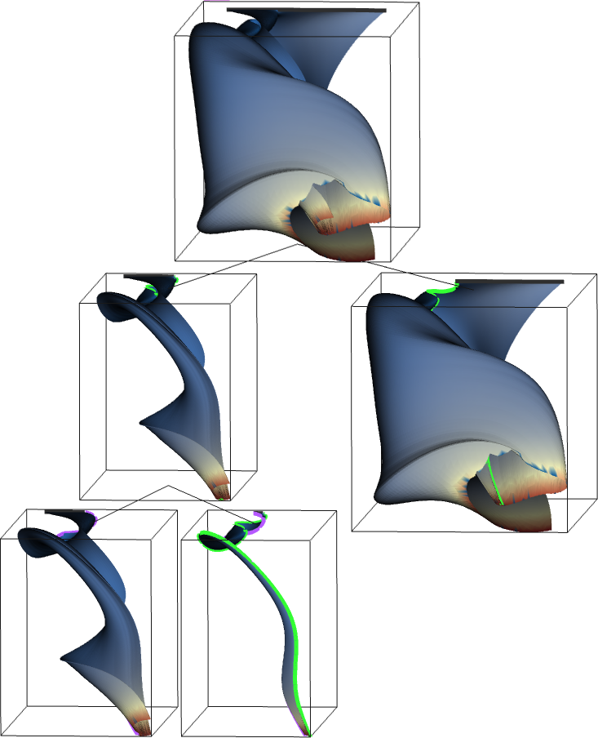
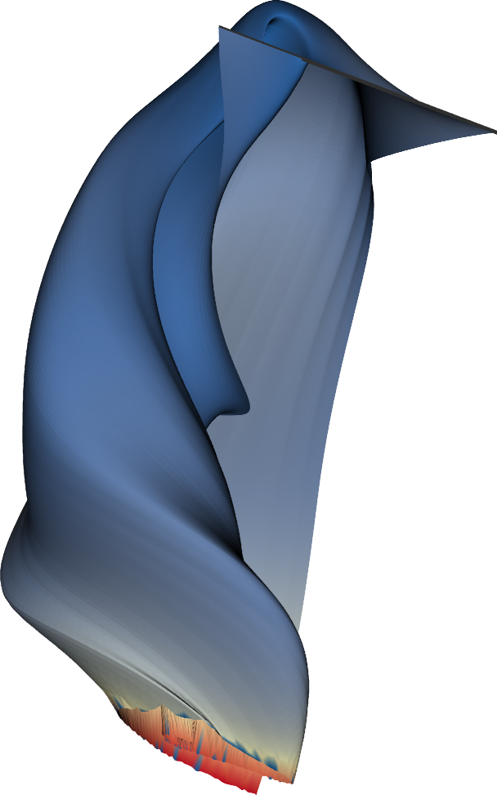
Interaction

Slide 43
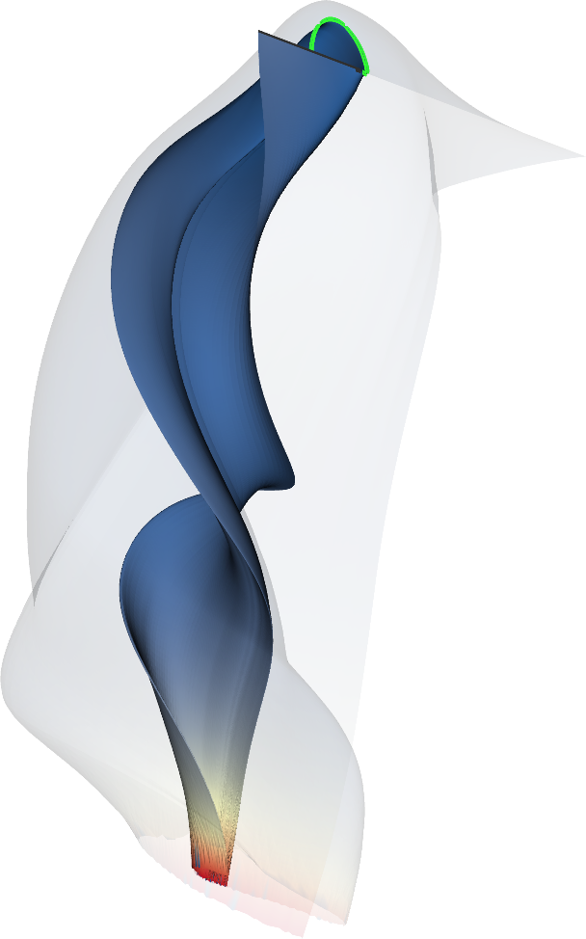
Interaction

Slide 44
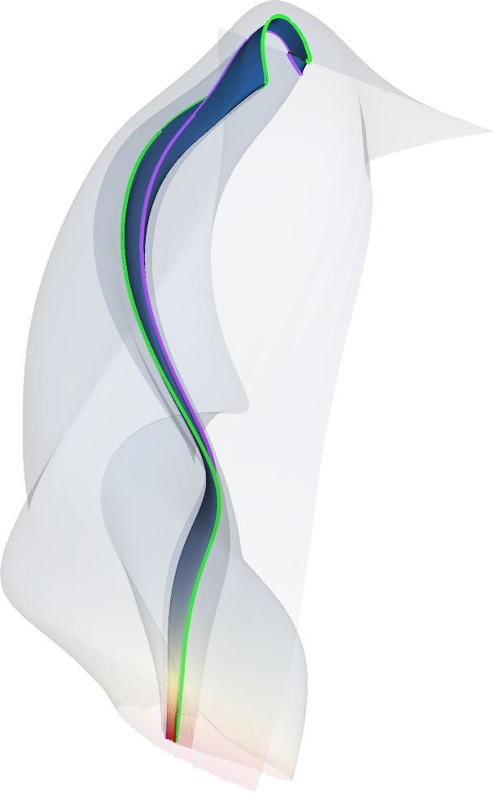
Interaction

Slide 45
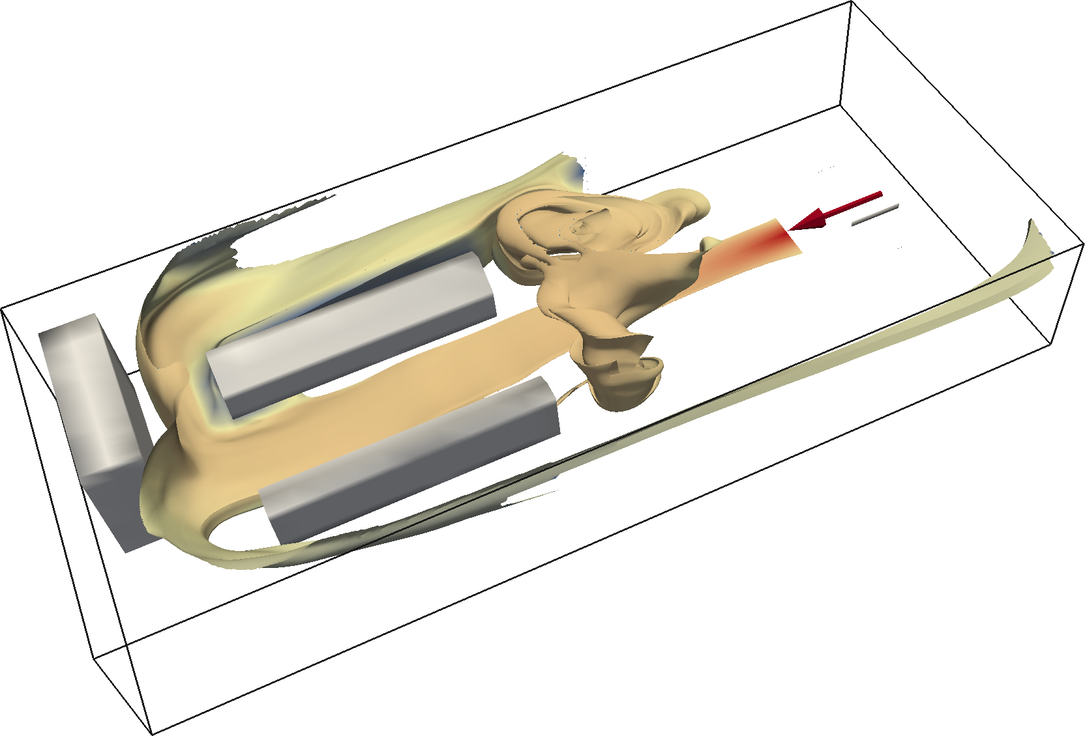
Results - Gas Leak

Slide 46
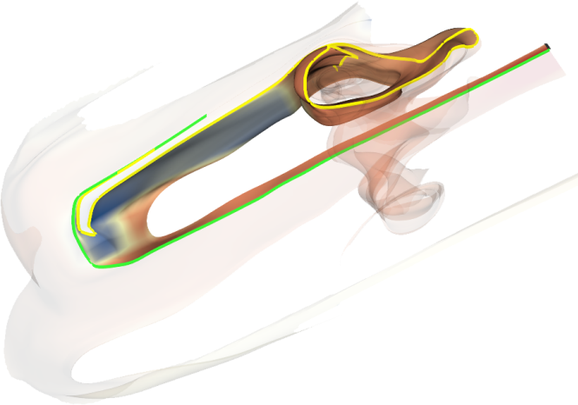
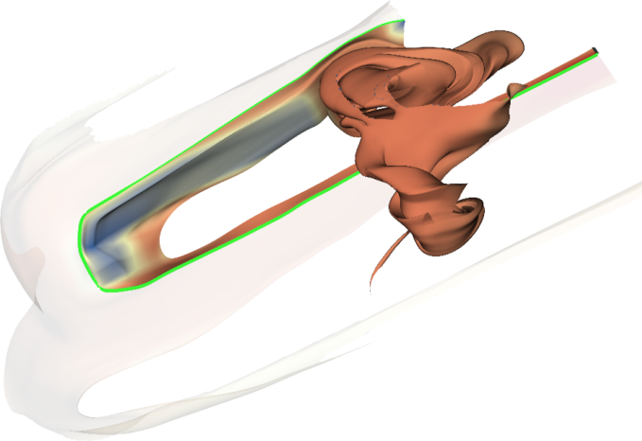
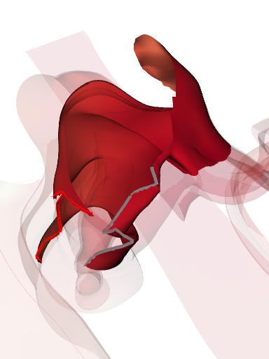
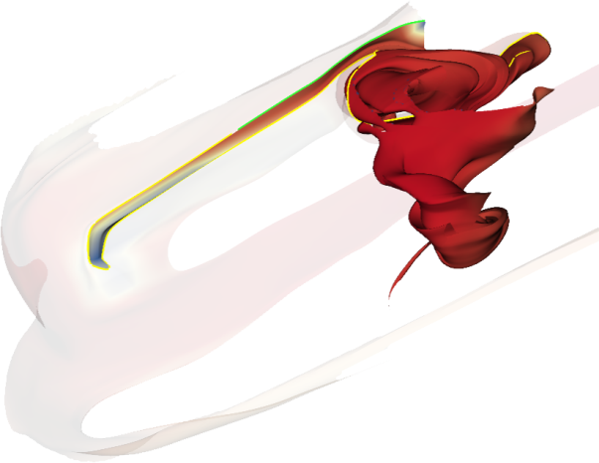
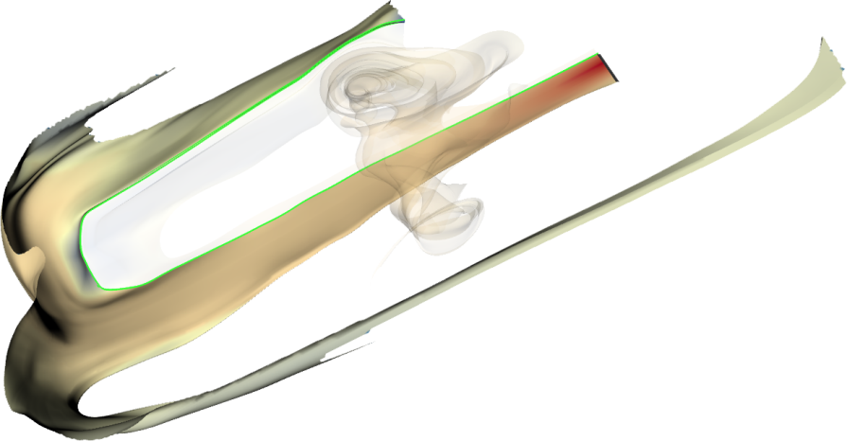
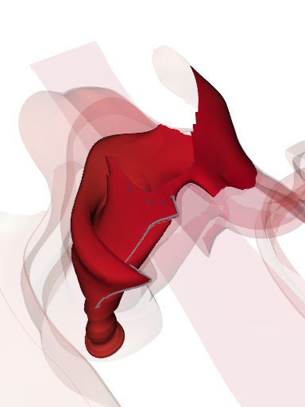
Results - Gas Leak

Slide 47
Summary & Future Work
So what?
the proposed generic framework can help designing succesful splitting and explosion algorithms
our splitting approach is the first which can effectively subdivide integral surfaces
the complexity measure adequatly approximate the degree of self-occlusion of a surface
And then?
extend the approach to path and other kinds of surfaces (or even volumes)
improve the versatility of the visualization system
boost performances via a GPU implementation

Slide 48
Thanks for your attention!
Questions?
Thanks to GexCon AS and AVL providing the datasets
The project SemSeg acknowledges the financial support of the Future and Emerging Technologies (FET) programme within the Seventh Framework Programme for Research of the European Commission, under FET-Open grant number 226042.
andrea.brambilla@uib.no www.ii.uib.no/vis

Slide 49
Flow in a Box

Slide 50
Surface Splitting
Notes:
What we do to solve this issue, we take the surface...

Slide 51
Surface Splitting

Slide 52
Surface Splitting
Notes:
The single pieces can be inestigated on their own
The rest of the surface can be displayed semi-transparent to provide contextual information
The cuts are not random but made according to a precise schema that I am going to explain

Slide 53
Interaction

Slide 54
Interaction

Slide 55
Interaction

Slide 56
Gas Leak

Slide 57
Gas Leak

Slide 58
Gas Leak - Right Vortex

Slide 59
Thanks for your attention!
Questions?
Thanks to GexCon AS and AVL providing the datasets
The project SemSeg acknowledges the financial support of the Future and Emerging Technologies (FET) programme within the Seventh Framework Programme for Research of the European Commission, under FET-Open grant number 226042.
andrea.brambilla@uib.no www.ii.uib.no/vis

Slide 60
Surface Complexity
How much a point «occludes» the rest of the surface
Precise evaluation not feasible!
p

Slide 61
Surface Complexity

Slide 62
Surface Complexity
p₂
p₃
p₁
pivot
cpx(p) = ∑_{x∈X}importance(x) ∙ abs( nrm(p) ● r / |r| )

