Slide 1


Illustrative Flow Visualization: State of the Art, Trends and Challenges
Andrea Brambilla¹, Robert Carnecky²,
Ronald Peikert², Ivan Viola¹, Helwig Hauser¹
¹ University of Bergen, Norway
² ETH Zurich, Switzerland

Slide 2

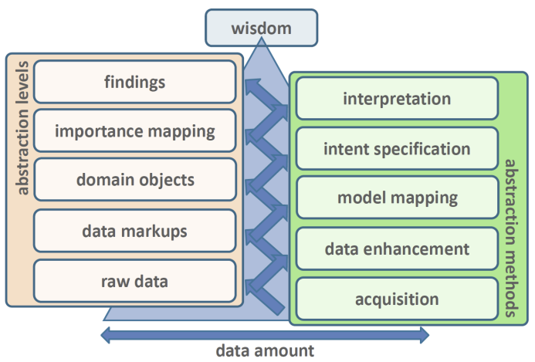
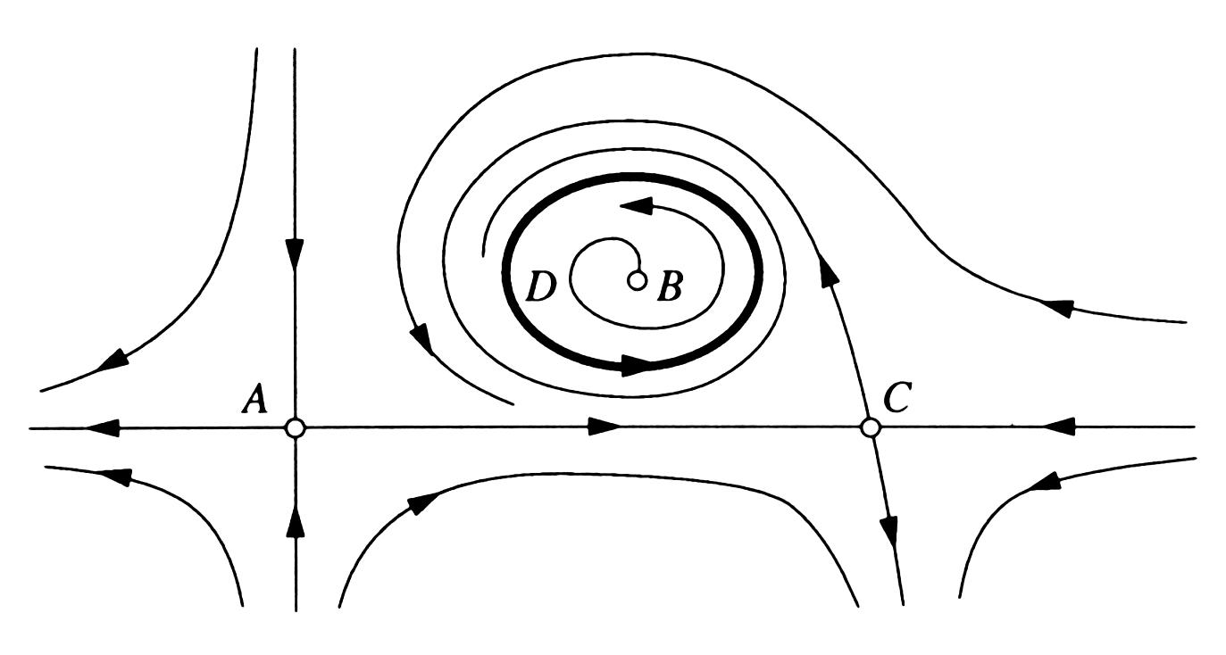
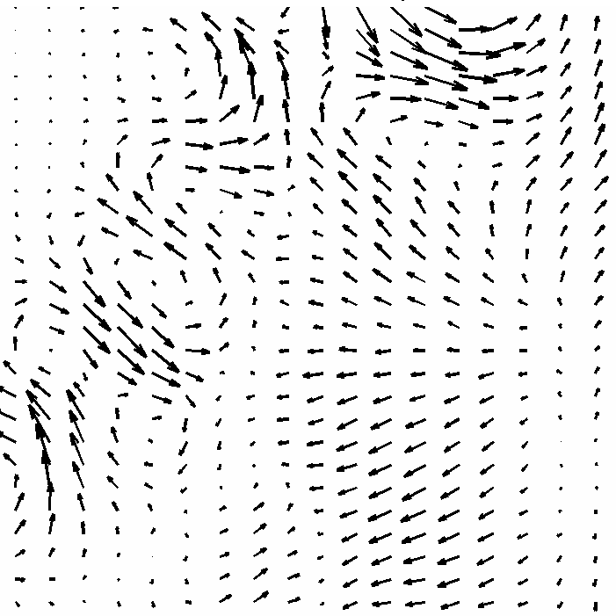
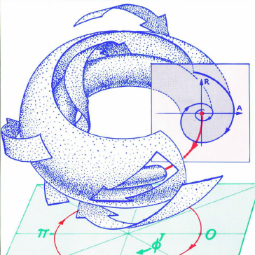
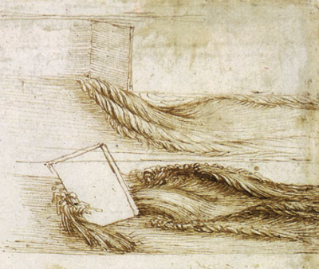
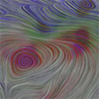
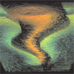
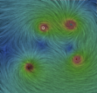
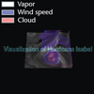
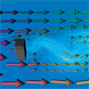
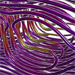

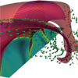
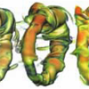
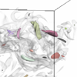
Outline
1. Introduction
1. Introduction
2. Traditional flow visualization
2. Traditional flow visualization
3. The illustrative paradigm
3. The illustrative paradigm
4. Illustrative flow visualization
4. Illustrative flow visualization
PE
PE
VM
VM
FE
FE
VE
VE
RD
RD
IS
IS
5. Conclusions and expectations
5. Conclusions and expectations
FF
FF

Slide 3
Outline
1. Introduction
1. Introduction
2. Traditional flow visualization
3. The illustrative paradigm
4. Illustrative flow visualization
PE
VM
FE
VE
RD
IS
5. Conclusions and expectations
FF

Slide 4

Motivation
Which image would you use for navigation?
Notes:
Left: As precise and photo-realistic as it gets, but: cluttered, important info hard to find
Right: Non-photo-realistic, simplified/distorted (e.g., roads), missing details, but: easily conveys task-relevant information
Zooming: normal image minification in the left image. adaptive abstraction of information on the right, thereby maintaining a constant density of information
Images from google maps.

Slide 5
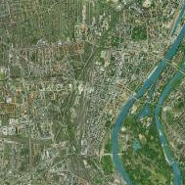
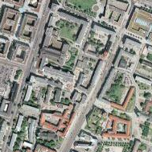
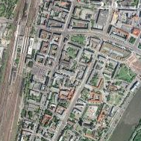
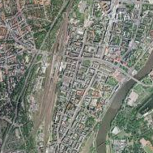
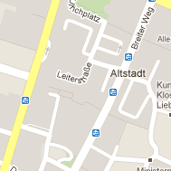
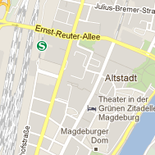
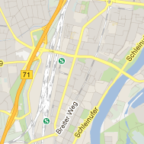

Motivation
Which image would you use for navigation?
Google maps
Google maps
Notes:
Left: As precise and photo-realistic as it gets, but: cluttered, important info hard to find
Right: Non-photo-realistic, simplified/distorted (e.g., roads), missing details, but: easily conveys task-relevant information
Zooming: normal image minification in the left image. adaptive abstraction of information on the right, thereby maintaining a constant density of information
Images from google maps.

Slide 6
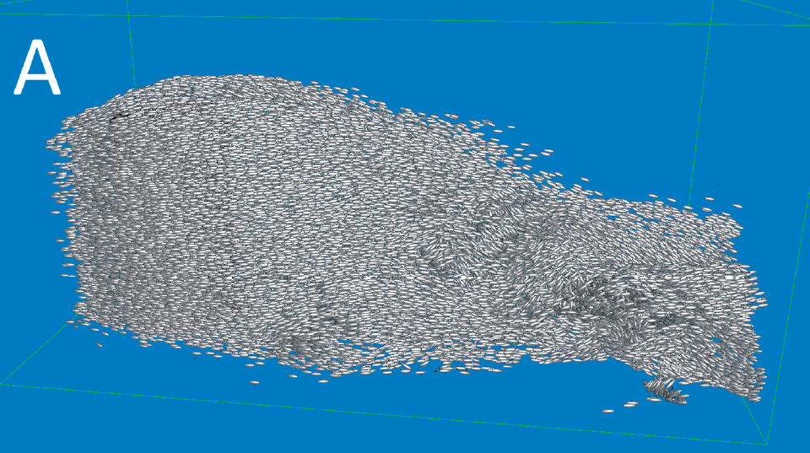
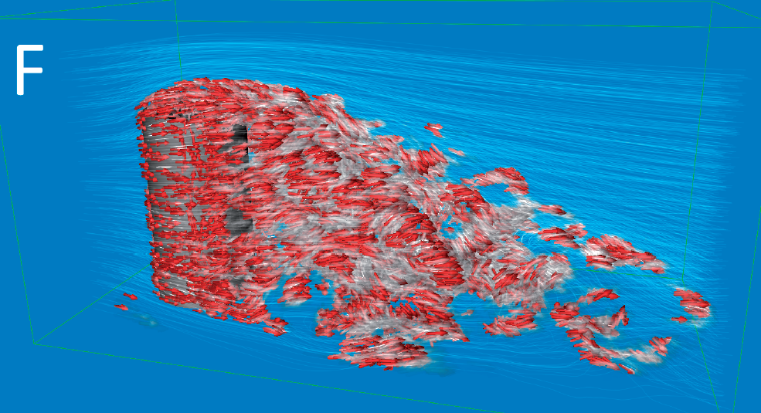
Motivation
Which image would you use for analysing the flow?
Bürger et al. 08
Bürger et al. 08
Notes:
K. Bürger et al., 2008

Slide 7
History
Is it something new?
Leonardo da Vinci, ca. 1500
Abraham and Shaw,1982

Slide 8
Data abstraction
Traditional visualization workflow

Slide 9
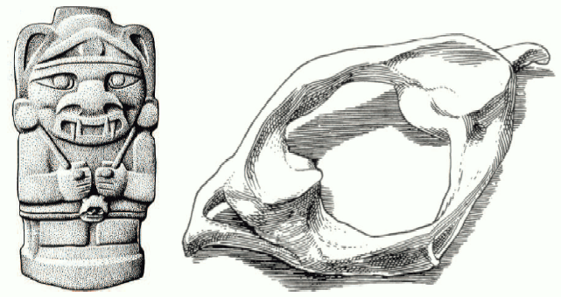
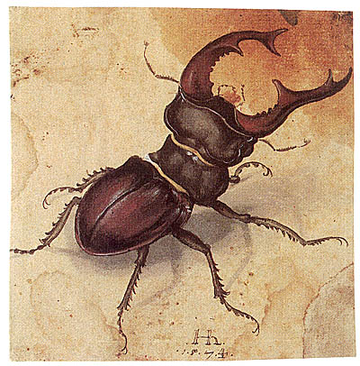
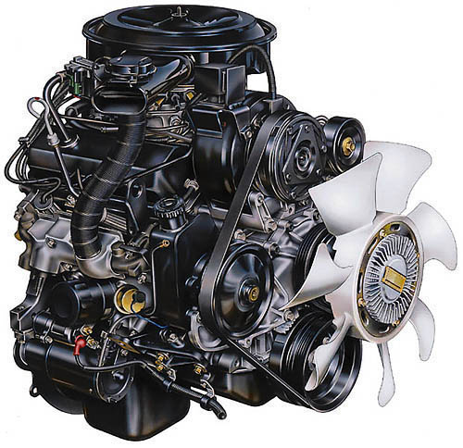
Illustrative Visualization
Computer aided interactive and expressive visualizations
Using visual abstraction techniques
Maximizing the amount of information conveyed
Inspired by works from artists and illustrators
Notes:
This is a general description of illustrative visualization properties, it builds on the example in the previous slide.

Slide 10
Outline
1. Introduction
2. Traditional flow visualization
2. Traditional flow visualization
3. The illustrative paradigm
4. Illustrative flow visualization
PE
VM
FE
VE
RD
IS
5. Conclusions and expectations
FF

Slide 11
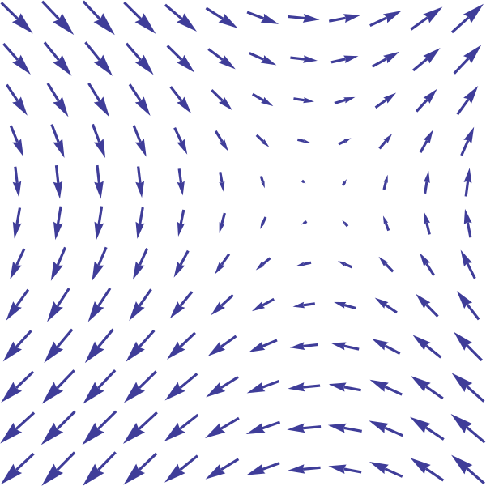

Flow and vector fields
Flow vector field

Slide 12
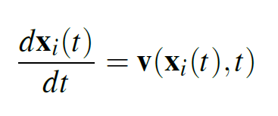
Flow and vector fields
Flow vector field
Flow motion

Slide 13
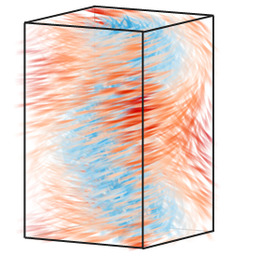
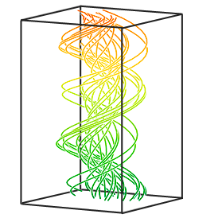
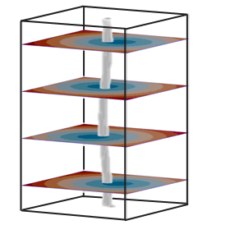
Flow abstraction
Data abstraction of the vector field
Raw Data
Integral Structures
Flow Features
Notes:
Three important levels of data abstraction used in flow visualization. They are usually mathematically well-defined and used in all (illustrative and non-illustrative) flow visualization methods.
Left: 3D volume visualization of a raw vector field
Middle: Integral lines. For example, the path of a massless particle in the flow (although these are probably stream lines in the image, path lines might be easier to people new to flow vis).
Right: Flow features = „objects of particular interest“
Vortices
Vector field topology
Lagrangian coherent structures
Shock waves
Separation/attachment lines

Slide 14
Flow abstraction: raw data
Raw Data
Integral Structures
Flow Features
Notes:
Three important levels of data abstraction used in flow visualization. They are usually mathematically well-defined and used in all (illustrative and non-illustrative) flow visualization methods.
Left: 3D volume visualization of a raw vector field
Middle: Integral lines. For example, the path of a massless particle in the flow (although these are probably stream lines in the image, path lines might be easier to people new to flow vis).
Right: Flow features = „objects of particular interest“
Vortices
Vector field topology
Lagrangian coherent structures
Shock waves
Separation/attachment lines

Slide 15
Flow abstraction: raw data
Simulation output
  Dense grid or mesh of values

Slide 16
Flow abstraction: integral structures
Raw Data
Integral Structures
Flow Features
Notes:
Three important levels of data abstraction used in flow visualization. They are usually mathematically well-defined and used in all (illustrative and non-illustrative) flow visualization methods.
Left: 3D volume visualization of a raw vector field
Middle: Integral lines. For example, the path of a massless particle in the flow (although these are probably stream lines in the image, path lines might be easier to people new to flow vis).
Right: Flow features = „objects of particular interest“
Vortices
Vector field topology
Lagrangian coherent structures
Shock waves
Separation/attachment lines

Slide 17
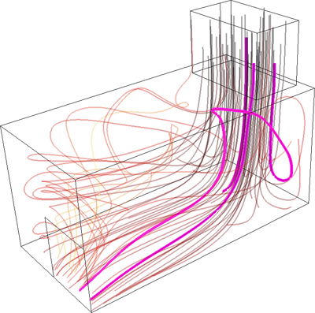
Flow abstraction: integral structures
Lines
  Streamline
  Pathline
  Streakline

Slide 18
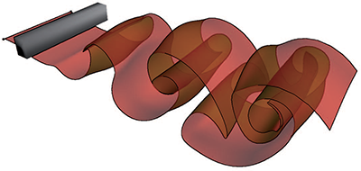
Flow abstraction: integral structures
Lines
  Streamline
  Pathline
  Streakline
Surfaces
  Streamline
  Pathline
  Streakline
Bürger et al. 09

Slide 19
Flow abstraction: flow features
Data abstraction of the vector field
Raw Data
Integral Structures
Flow Features
Notes:
Three important levels of data abstraction used in flow visualization. They are usually mathematically well-defined and used in all (illustrative and non-illustrative) flow visualization methods.
Left: 3D volume visualization of a raw vector field
Middle: Integral lines. For example, the path of a massless particle in the flow (although these are probably stream lines in the image, path lines might be easier to people new to flow vis).
Right: Flow features = „objects of particular interest“
Vortices
Vector field topology
Lagrangian coherent structures
Shock waves
Separation/attachment lines

Slide 20
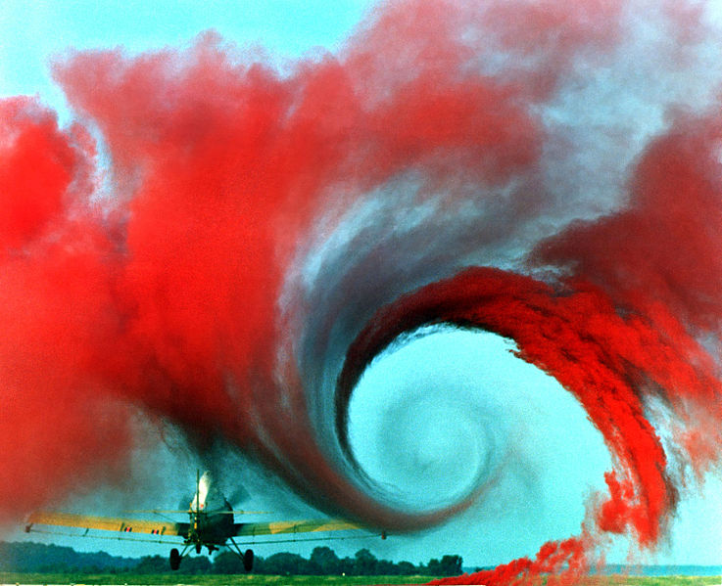
Flow abstraction: flow features
Vortices
Wikipedia
Notes:
areas associated with swirling motion
they are almost ubiquitous in flows and are of vital importance in many applications.
The main problem is that a formal, well accepted definition of vortex has yet to be found.

Slide 21
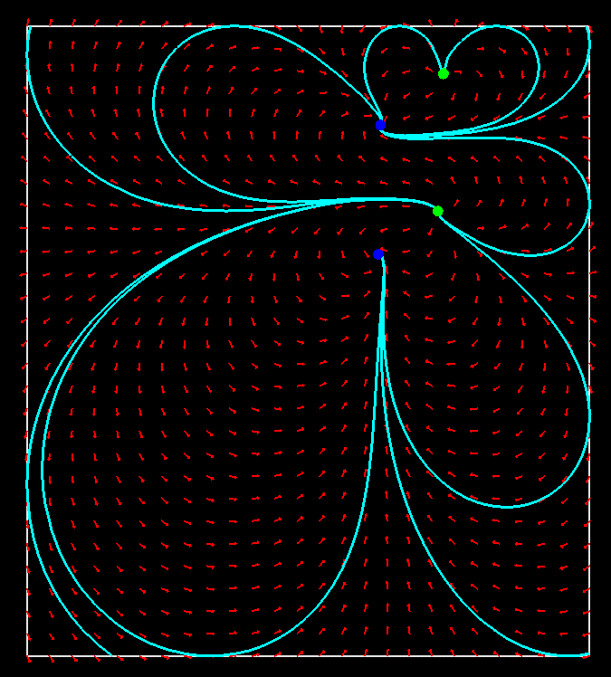
Flow abstraction: flow features
Vortices
Vector field topology
Scheuerman et al. 00
Notes:
obtained by integrating selected streamlines close to critical points (i.e. points p 2 Rn where v(p) = 0), usually referred to as separatrices.
They partition the vector field in areas that asymptotically show coherent behavior.
VFT is very effective for 2D steady flows, but its extension to 3D is problematic because of cluttering and occlusion issues.

Slide 22
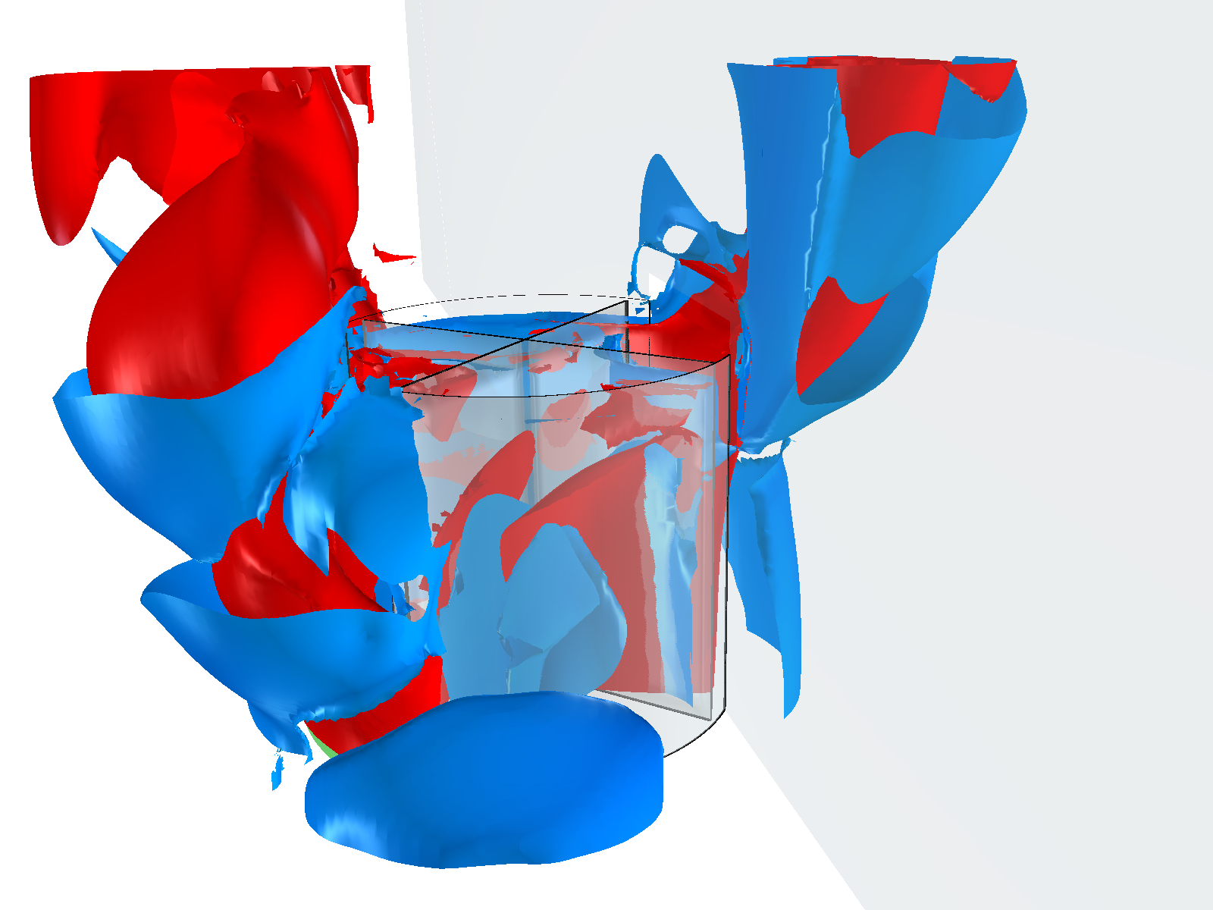

Flow abstraction: flow features
Vortices
Vector field topology
Lagrangian coherent structures
Kasten et al. 11
Schindler et al. 11
Notes:
from a conceptual point of view, they are an attempt to extend VFT to unsteady flows.
A formal definition has not yet been given and the research on this subtopic is very active.
Useful information can be found in related literature [Hal01,SLM05,PPF11].

Slide 23
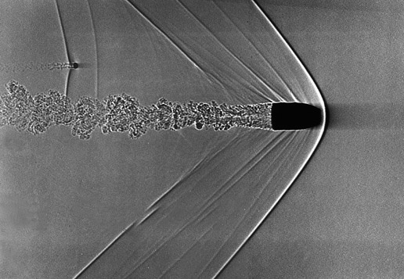
Flow abstraction: flow features
Vortices
Vector field topology
Lagrangian coherent structures
Shock waves
NASA
Notes:
typical of flows around aircraft, they are characterized by sharp discontinuities in physical flow attributes.
A straightforward way to detect them is to look for edges in scalar quantities such as pressure, density or velocity magnitude.
A bullet traveling through air at about 1.5 times the speed of sound can be seen in this image.

Slide 24
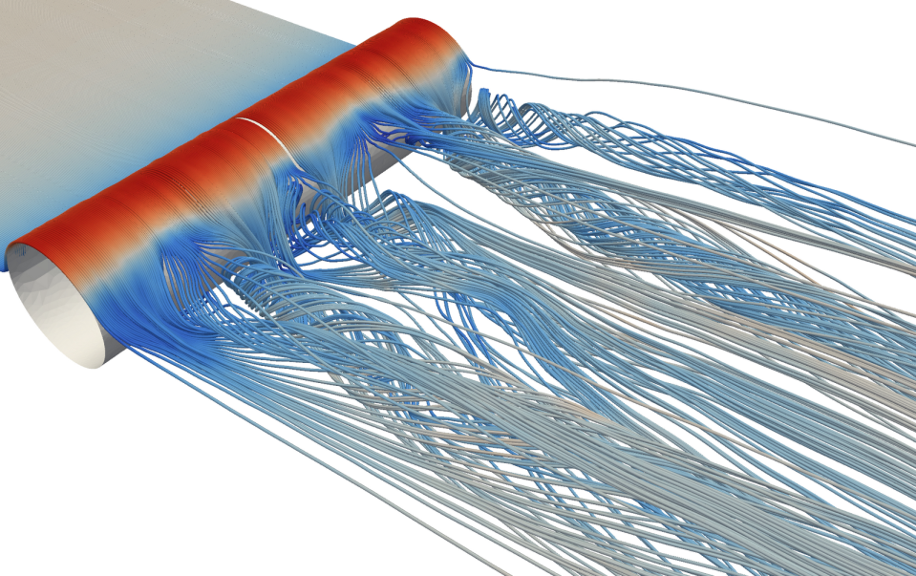
Flow abstraction: flow features
Vortices
Vector field topology
Lagrangian coherent structures
Shock waves
Attachment and separation lines
Hoffman and Jansson 11
Notes:
only present in conjunction with solid bodies or boundaries, these are the curves where the flow abruptly moves away (separation)
or towards (attachment) the surface of the solid object.

Slide 25
Outline
1. Introduction
2. Traditional flow visualization
2. Traditional flow visualization
3. The illustrative paradigm
4. Illustrative flow visualization
PE
VM
FE
VE
RD
IS
5. Conclusions and expectations
FF

Slide 26
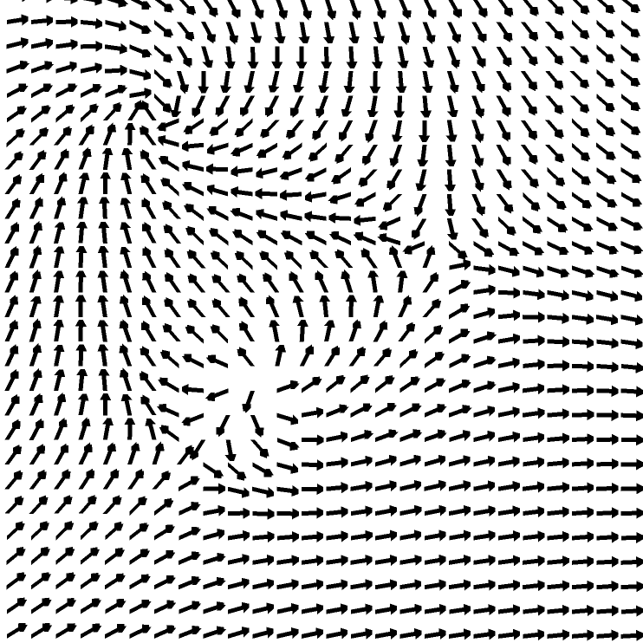
Flow visualization techniques
Direct visualization
Weiskopf and Erlebacher 05
Notes:
the data is directly mapped to a visual representation, without complex conversions or extraction steps.
Arrow glyphs, color coding and volume rendering are the core of this category.

Slide 27
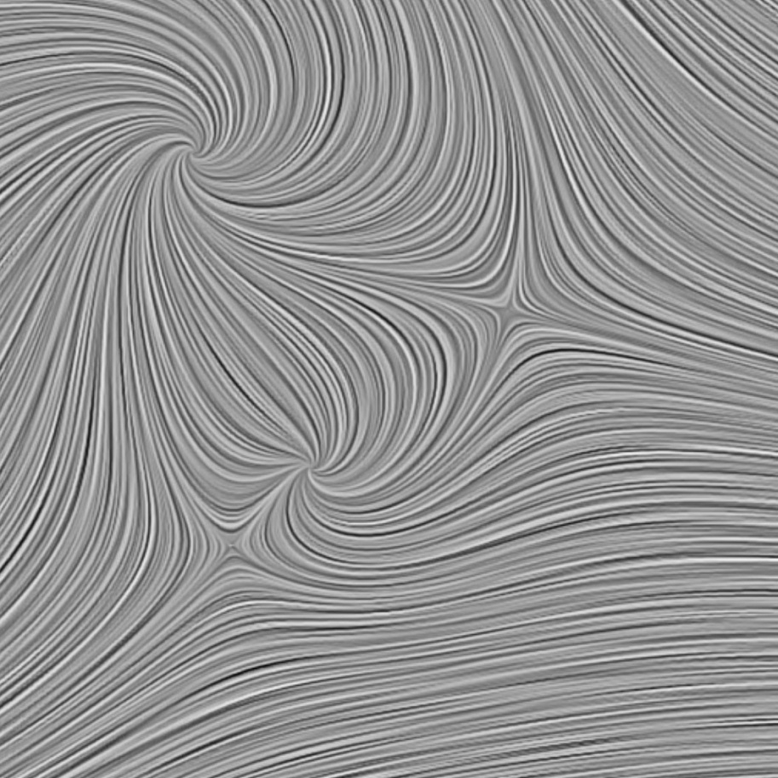
Flow visualization techniques
Direct visualization
Texture-based visualization
Weiskopf and Erlebacher 05
Notes:
a dense representation of the flow is obtained using local flow attributes to create and/or warp a noise texture;
more details on this topic can be found in [SMM00] and [LHD04].
STAR by Bob Laramee

Slide 28
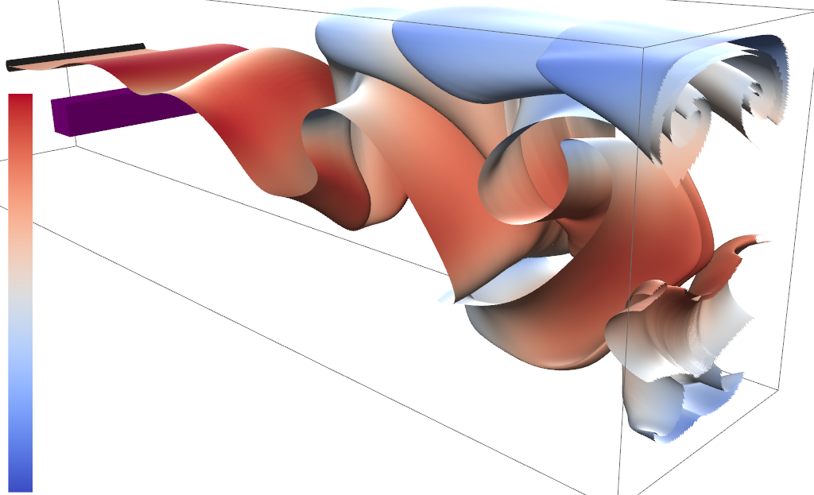
Flow visualization techniques
Direct visualization
Texture-based visualization
Geometric visualization
McLoughlin et al. 09
Notes:
in order to better convey flow dynamics, integral structures are used as a basis for the graphical representation;
a recent survey by McLoughlin et al. [MLP10] thoroughly describes this category of approaches.

Slide 29
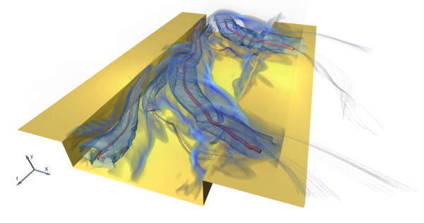
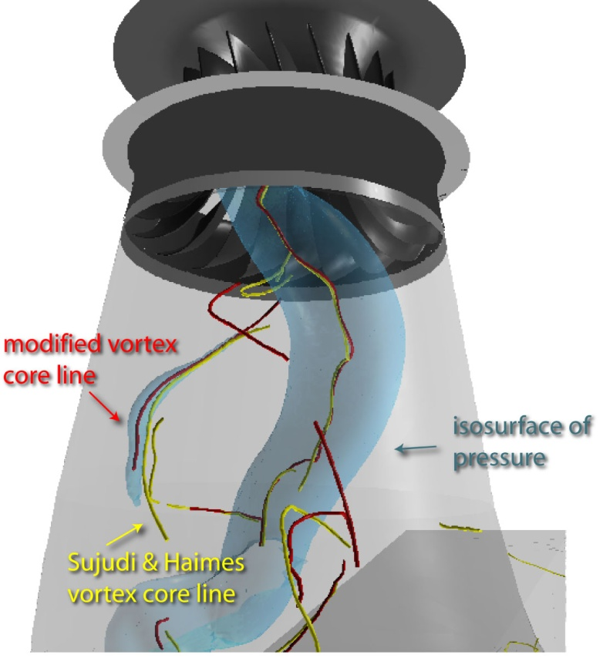
Flow visualization techniques
Direct visualization
Texture-based visualization
Geometric visualization
Feature-based visualization
Fuchs et al. 08
Notes:
a sparse visualization is obtained focusing only on the most significant areas of the vector field;
a comprehensive survey on features extraction and related visualization techniques has been presented in 2003 by Post et al. [PVH03].

Slide 30
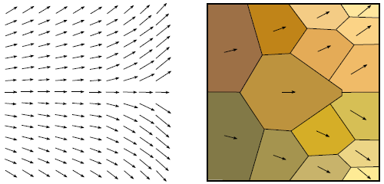
Flow visualization techniques
Direct visualization
Texture-based visualization
Geometric visualization
Feature-based visualization
Partition-based visualization
Salzbrunn et al. 08
Notes:
includes all those approaches aimed at effectively partitioning the spatial and temporal domain according to flow properties.

Slide 31
Outline
1. Introduction
2. Traditional flow visualization
3. The illustrative paradigm
3. The illustrative paradigm
4. Illustrative flow visualization
PE
VM
FE
VE
RD
IS
5. Conclusions and expectations
FF

Slide 32
Challenges in flow visualization
Naive use of data abstraction leads to problems

Slide 33
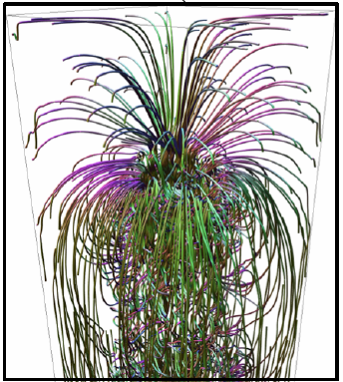
Challenges in flow visualization
Naive use of data abstraction leads to problems
Cluttering
Chen et al. 11
Notes:
streamlines cluttered and occluding each other. Image from „An illustrative visualization framework for 3d vector fields” by Chen et al.

Slide 34
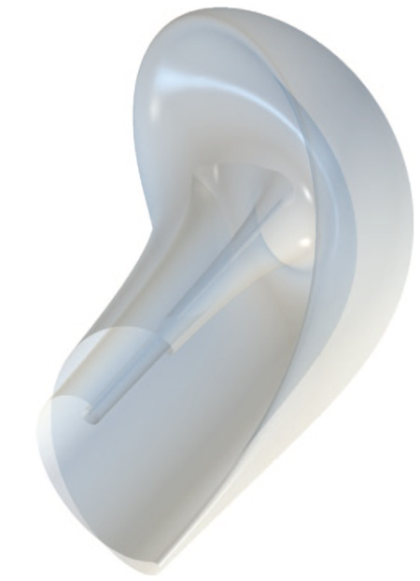
Challenges in flow visualization
Naive use of data abstraction leads to problems
Cluttering
Shape perception
Carnecky et al. 11
Notes:
stream surfaces are often heavily folded, difficult to uderstand the inner parts of the surface shape. Image from Roberts first (unpublished) paper.

Slide 35
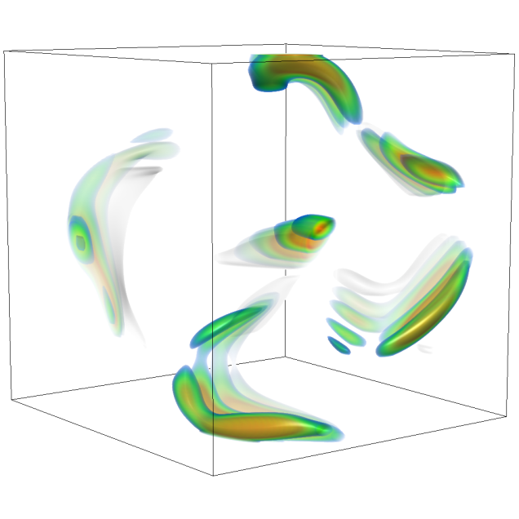
Challenges in flow visualization
Naive use of data abstraction leads to problems
Cluttering
Shape perception
Temporal dimension
Hsu et al. 10
Notes:
flows often include time-dependent data. visualizing the the temporal evolution of the flow with a single image is difficult. This is actually a somewhat illustrative image, I just haven‘t found a suitable non-illustrative image. Image from „Depicting Time Evolving Flow with Illustrative Visualization Techniques“ by Hsu at al.

Slide 36
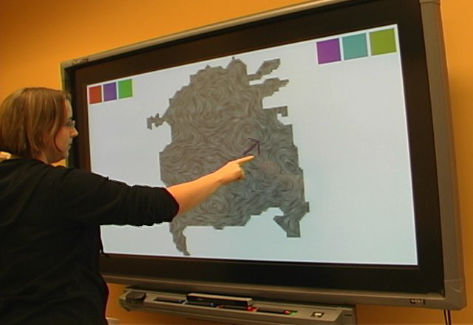
Challenges in flow visualization
Naive use of data abstraction leads to problems
Cluttering
Shape perception
Temporal dimension
Interactivity
Isenberg et al. 08
Notes:
Interactivity: techniques should be fast enough to allow for an interactive exploration of the data set (no image)

Slide 37
Illustrative visual abstraction
Use visual abstraction
Notes:
There are several classes of illustrative visual abstraction which deal with the aforementioned challenges.

Slide 38
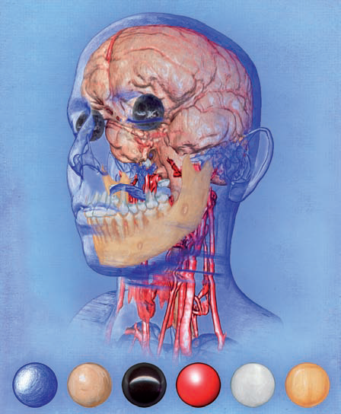
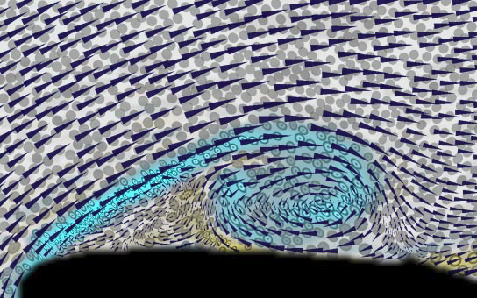
Illustrative visual abstraction
Use visual abstraction
Perceptual Effectiveness
Bruckner and Gröller 07
Kirby et al. 99
Notes:
depth/shape perception, local properties conveyed. Left Image from „Visualizing multivalued data from 2d incompressible flows using concepts from painting.“ by Kirby et al.

Slide 39


Illustrative visual abstraction
Use visual abstraction
Perceptual Effectiveness
Visibility management
Chen et al. 11
Kevin Hulsey Illustration, Inc
Notes:
occlusion/cluttering reduced, expressiveness of visual space maximized. Middle image by from „An illustrative visualization framework for 3d vector fields” by Chen et al.

Slide 40


Illustrative visual abstraction
Use visual abstraction
Perceptual Effectiveness
Visibility management
Focus emphasis
Correa et al. 07
Viola et al. 04
Notes:
data in focus is clearly visible, well depicted and not occluded. Right image from „Illustrative deformation for data exploration.“ by Correa et al.

Slide 41


Illustrative visual abstraction
Use visual abstraction
Perceptual Effectiveness
Visibility management
Focus emphasis
Visual explanation
Ma et al 12
Bruckner 05
Notes:
description/explanation of the phenomenon. Related to storytelling and guided vizualization.

Slide 42
Outline
1. Introduction
2. Traditional flow visualization
3. The illustrative paradigm
4. Illustrative flow visualization
PE
VM
FE
VE
RD
IS
5. Conclusions and expectations
FF
4. Illustrative flow visualization

Slide 43


Classification, why and how
Goal: help application experts (visualization users) to identify the right technique according to their needs
Guidelines:
  The visual advantages of the different techniques should be emphasized
  The reference representation of the flow data has to be captured
  The typical visualization user can have limited knowledge of visualization
Data representation
Visualization user Visualization needs
Technical vis details
4. Illustrative flow visualization

Slide 44
Which flow data representation?
Traditional flow-vis classification:
  Direct
  Texture-based
  Geometric
  Feature-based
  Partition-based
Based on the implementation, too technical!
Move the focus on flow representations:
Raw Data
Integral Structures
Flow Features
4. Illustrative flow visualization
Notes:
Raw data:
- original data produced by simulations or measurements (such as velocity or pressure), or information directly derivable from it (curl or gradients)
- usually defined at the vertices or cells of the sampling grid
- used to looc at local properties of the flow
Integral structures:
- integral curves/surfaces/volumes
- usually displayed as linear structures (lines, tubes, ribbons), shaded surfaces or volume rendered
- used to look at more persistent/long term charachteristic of the flow
Flow features:
- subsets of the data perceived as particularly relevant by the user
- different definitions and visualization techniques

Slide 45
Illustrative flow vis classification
Data representation
Visualization needs
PE
VM
FE
VE
PERCEPTUAL EFFECTIVENESS
VISIBILITY MANAGEMENT
FOCUS EMPHASIS
VISUAL EXPLANATION
RAW DATA
INTEGRAL STRUCTURES
FLOW FEATURES
RD
X
➔
IS
FF
Easy identification of suitable techniques:
  “What flow data representation am I dealing with?”
  “What visual enhancements do I need?”
4. Illustrative flow visualization

Slide 46




The right set of techniques, example
PE
VM
FE
VE
“What flow data representation am I dealing with?”
“What visual enhancements do I need?”
RD
IS
FF
4. Illustrative flow visualization
Notes:
Example 1: Equivalent ration in [0.5; 1.7] flammable → RD / FE
Example 2: Mixing of air and gas, swirling area along particles trajectory → IS / VM
In both cases, different interesting aspects over time → VE

Slide 47
Illustrative flow vis classification
PE
VM
FE
VE
RD
IS
FF
4. Illustrative flow visualization

Slide 48










Raw Data / Perceptual Effectiveness
PE
VM
FE
VE
Perception of nD attributes
Depth perception / ordering
Visualization of multiple attributes
RD
IS
FF
4. Illustrative flow visualization

Slide 49



RD / PE - Glyphs and volumes
Expressive Glyphs
Smart placement
Convey multiple attributes
Volume Rendering
Show inner parts
Visual enhancements
Kirby et al. 99
Stompel et al. 02
Svakhine et al. 05
4. Illustrative flow visualization
Notes:
Kirby et al. 1999: velocity direction -- velocity magnitude (arrow area) -- voritcity direction (color) -- strain and shear (ellipses)
Stompel et al. 2002: GPU, strokes for velocity, various NPR enhancement (silhouette, cool2 warm, color and transparency based on depth and gradient of a scalar field), Supports also temporal context. --
Svakhine et al. 2005: 2D TF, silhouette enhancement, contour-banded rendering – banding of based on the magnitude of D2(temperature): high -> color / low -> grayscale

Slide 50





RD / PE - Texture advection
Texture Advection
Local representation of trajectories
Many different approaches
3D LIC Rezk-Salama et al. 99
LIC
Cabral and Leedom 93
LEA
Jobard et al. 01
IBFV
Van Wijk 02
Data Fusion Wong et al. 02
Clear representation of direction
Convey additional information
4. Illustrative flow visualization
Notes:
LIC, Cabral and Leedom 93: convolution along streamlines, no vel magnitute, easy localization of critical points
LEA, Jobard et al. 01: based on backward integration of particles and advection of a noise texture
IBFV, van Wijk 02: warping of noise texture, takes into account velocity magnitude
3D LIC, Rezk-Salama et al. 99: LIC in 3D, heavy cluttering
Data Fusion, by Wong et al.: shows how texture advection can be easily combined with other basic techniques, COLOR by Dir, HEIGHT by ...

Slide 51










Raw Data / Visibility Management
PE
VM
FE
VE
2D Raw Data
  Minimal visibility issues
  Visibility of multiple attributes
RD
IS
FF
Urness et al. 03
Urness et al. 04
3D Raw Data
  Highly cluttered...
  Focus Emphasis is more effective!
4. Illustrative flow visualization
Notes:
Urness et al. 03, 04: Enhancement of texture advection vis to visualize multiple attributes. Left to right: change of contrast, change of lightness, embossing and color mixing

Slide 52




Raw Data / Focus Emphasis
PE
VM
FE
VE
Determining the focus
Location-based vs attribute-based
Showing relevant data
RD
IS
FF
4. Illustrative flow visualization
Notes:
What is important?
Definition of focus based on attributes queries or feature detectors
Once focus has been defined, how should it be shown? Ex, selection of areas with high vorticity in the ABC flow

Slide 53





RD / FE - Dye advection
Dye advection
Based on dye injection experiment
Flow behaviour in selected areas
Darelius 08
Telea and Van Wijk 03
Weiskopf and Ertl 04
Weiskopf et al. 05
Li et al. 08
4. Illustrative flow visualization
Notes:
Darelius 2008: Ekman helix in an undersea canion, in „Deep-Sea Research I“
Telea and van Wijk 2003: 3D IBFV
Weiskopf and Ertl 2004: 3D unsteady IBFV on the GPU, based on volume rendering
Weiskopf et al. 2005: modify the density of dye according to the convergence and divergence of the flow
Li et al. 2008: formulate the problem according to physics law in order to make results closer to the physical experiment

Slide 54





RD / FE - Importance measure
Data with importance attribute
Manual vs automatic
Discrete vs fuzzy
Iterative refinement
Correa et al. 07
Hauser and Mlejnek 03
Wang et al. 11
Weiskopf et al. 07
4. Illustrative flow visualization
Notes:
Hauser and Mlejnek 2003: user specified (scatterplot or histogram) fuzzy degree of interest + volume rendering (transparency dependent on DOI)
Weiskopf et al. 2007: swirling areas detected with lambda2, focus opaque with warm color, context transparent with cold colors
Correa et al. 2007: fuzzy importance measure, context is deformed according to a deformation template
Wang et al. 2011: example of entropy based F+C (from information theory), specifically, visualization based on trasnfer entropy, i.e. a measure of causal dependencies between variables

Slide 55
Illustrative flow vis classification
PE
VM
FE
VE
RD
IS
FF
4. Illustrative flow visualization

Slide 56




Integral Structures / Perceptual Effectiveness
PE
VM
FE
VE
Depth perception / ordering
Waste of visual resources
Interactivity issues
RD
IS
FF
4. Illustrative flow visualization

Slide 57




IS / PE – Dense vs sparse
Dense line bundles
Dense domain covering
Need for depth cues
Sparse integral curves
Geometric representation
Convey local properties
Schroeder et al. 91
Mallo et al. 05
Stoll et al. 05
Everts et al. 09
4. Illustrative flow visualization
Notes:
Mallo et al. 05: Illuminated lines revised, based on Illuminated streamline by Zöckler et al. 1991
Everts et al. 2009: Depth dependent halos
Schroeder et al. 1991: stream poligon
Stoll et al. 2005: stylized line primitives

Slide 58



IS / PE - Interactivity
Integration and Rendering
Expensive numerical integration
High resolution results
GPU implementation to guarantee interactivity
Schirski et al. 04
Bürger et al. 09
Von Funck et al. 08
Krishnan et al. 09
4. Illustrative flow visualization
Notes:
Schirski et al. 2004: Virtual Tubelets (billboarding of tubes)
Von Funck et al 2008: Smoke Surfaces (no retriangulation, opacity depending on triangle shape, not on GPU!)
Bürger et al 2009: streak surfaces – gpu implementation (patch-based vs particle based surface representation), texturing and shading
Krishnan et al. 2009: streaksurfaces - gpu implementation (decoupling of advection and surface adaptation), shading and texturing
last two, published in the same issue of TVCG

Slide 59




Integral Structures / Visibility Management
PE
VM
FE
VE
Selection of seeding location
Effective distribution
Cluttering and occlusion
RD
IS
FF
Carnecky et al. 11
4. Illustrative flow visualization

Slide 60







IS / VM - Automatic seeding
Entropy-based seeding
Maximize the amount of information
Pruning to improve visibility
Flow clustering
Few line for each cluster
Controllable strategy
Marchesin et al. 10
Telea and Van Wijk 99
Chen et al. 11
Griebel et al. 04
4. Illustrative flow visualization
Notes:
Telea and Van Wijk 99: bottom-up approach, iteratively merge the most similar clusters, similarity measure has fdifferent parameters tat let the user control the clustering process
Griebel et al. 04: more complex model, based on energy minimization, leads to clusters which are aligned with the flow
Marchesin et al. 10: precomputed pool, selection of which streamline should be shown according to image space occlusion, and streamline entropy
Chen et al. 11: seeding in high entropy area, clustering according to linear and angular entropy, only a couple of streamline per cluster

Slide 61






IS / VM - Integral lines distribution
Smart distribution of integral lines
Optimize the visual space
No cluttering issues
Jobard and Lefer 97
Li et al. 08
Li and Shen 07
4. Illustrative flow visualization
Notes:
Jobard and Lefer 1997: Seeding on a regular grid vs Evenly spaced streamlines, choose a seeding pt from a minimal distance and integrate until it is too close to another streamline
Li et al. 2008: emphasize essential streamlines, deemphasize trivial/repetitive ones, use a dissimilarity measure to decide if a streamline is useful or not
Li and Shen 2007: seeding on the image plane and backprojection, provides also level of detail rendering, depth peeling, and stylized rendering.

Slide 62





IS / VM - Surfaces and self occlusion
Illustrative surface rendering
Show occluded areas
Additional flow information
Löffelmann et al. 1997
Born et al. 10
Carnecky et al. 11
Hummel et al. 10
Carnecky et al. 12
4. Illustrative flow visualization
Notes:
Löffelmann et al. 1997: Stream arrows
Born et al. 2010: contour lines, halftoning, flow direction on the surface as oriented streamlines, movable cuts and slabs for interactive exploration
Hummel et al. 2010: normal and angle based transparency, texturing according to s-t values
Carnecky et al. 11: global transparency, enhanced with silhouettes
Carnecky et al 12: the same, enhanced with LIC-like texture

Slide 63


Integral Structures / Focus Emphasis
PE
VM
FE
VE
Data representation of the focus
Visual representation of the focus
RD
IS
FF
4. Illustrative flow visualization
Notes:
Focus can be a spatial location, or specified over raw data, or on integral structures
How the focus should be shown, according to what is the focus (as a seeding structure? Higher line density? Shaded surface?)

Slide 64




IS / FE - Focus as seeding
Selection of the seeding areas
Manual vs Automatic
Motion of specific particles
Wiebel and Scheuermann 05
Mattausch et al. 03
Krüger et al. 05
Ferstl et al. 10
4. Illustrative flow visualization
Notes:
Mattausch et al. 2003: shading effects for streamlines, streamlines are seeded from the green area (backward and forward integration)
Krüger et al 2005: particle system on the GPU, particle seeded from the «probe» volume with different strategies (random or regular)
Wiebel and Scheuermann 2005: path and streak lines through a an eyelet (specific point), eyelet placed manually or according to a local instability measure
Ferstl et al. 10: seeding streaksurfaces from FTLE ridges

Slide 65




IS / FE - Focus on integral lines
Focus on integral lines
Clear depiction of selected lines
Motion of specific particles
Wei et al. 10
Fuhrmann and Gröller 98
Jones and Ma 10
Mattausch et al. 03
4. Illustrative flow visualization
Notes:
Fuhrmann and Gröller 1998: dashtubes, magic lenses (in object space), remove lines between viewer and lens, higher density behind the lens
Mattaush et al. 2003: same as the previous slide, but now with higher density in the focus area
Wei et al. 2010: selection and clustering via a sketch based interface
Jones and Ma 2010: focus on specific integral lines, remove occlusion, show relationships with surrounding geometry (red yellow -> velocity, blue green -> distance)

Slide 66
Illustrative flow vis classification
PE
VM
FE
VE
RD
IS
FF
4. Illustrative flow visualization

Slide 67


Flow Features / Perceptual Effectiveness
PE
VM
FE
VE
No approaches in this category
Usually no perceptual issues
Possible developments wrt. new features
RD
IS
FF
?
Jiménez 08
Garth et al. 07
4. Illustrative flow visualization
Notes:
Garth et al. 07: Example of LCS in the delta wing dataset (central part of left wing)
Jiménez 08: turbulent separation from a boundary layer

Slide 68



VM - Temporal Implosion
Temporal Implosion
Statically depict temporal information
Applicable to different kinds of data
PE
VM
FE
VE
RD
IS
FF
Van Pelt et al. 11
Balabanian et al. 08
Hsu et al. 10
4. Illustrative flow visualization
Notes:
van Pelt et al. 2011: Temporal implosion technique based on particle trajectories, used to improve depiction of blood flow
Balabanian et al. 2008: 4D raycasting, temporal style transfer function
Hsu et al. 2010: Superimposition of timestep with different rendering styles or displacement

Slide 69

Flow Features / Focus Emphasis
PE
VM
FE
VE
Feature = Obj of interest ~ Focus
Feature extraction ~ Focus Emphasis
Many feature types and representations
RD
IS
FF
Muelder and Ma 09
Ferstl et al. 10
Weiskopf et al. 07
4. Illustrative flow visualization
Notes:
Muelder and Ma 2009: extraction and tracking features (vortices in this case), example of Focus Emph. For flow features

Slide 70
Illustrative flow vis classification
PE
VM
FE
VE
RD
IS
FF
4. Illustrative flow visualization

Slide 71







Visual Explanation
Explanation of complex processes
Based on the idea of storytelling
Relevant portions of data over time
Both data and visual abstractions
PE
VM
FE
VE
RD
IS
FF
Wohlfart and Hauser 07
Ma et al. 12
4. Illustrative flow visualization
Notes:
Wohlfart and Hauser 07: Storytelling for interactive volume visualization in the context of medical imaging
Ma et al. 12: Remarks and comments on storytelling, with notable application examples, i.e.:
The Bay Model at the Exploratorium in San Francisco, interaction with a scientifically accurate model of tides, currents, and rivers
Science-On-A-Sphere, by Scientific visualization Studio (NASA)
Storyboard of NASA’s Lunar Reconnaissance Orbiter Mission

Slide 72




Visual Explanation
Akiba et al. 10
Bürger et al. 08
Iwata et al. 11
4. Illustrative flow visualization
Notes:
Akiba et al. 2010: Storytelling framework, templates for spatial and temporal transitions, blending between shading effects, highlights of interesting areas... But completely manual!
Bürger et al. 2008: extension of the particle system shown a few slides ago (FE/IS), different vis styles according to motion coherence (flow clustering according to velocity direction)
Iwata et al. 2011: sketch based interface to quickly create simple 2D models, coupled with SPH simulation to show flow behaviour

Slide 73
Outline
1. Introduction
2. Traditional flow visualization
3. The illustrative paradigm
4. Illustrative flow visualization
PE
VM
FE
VE
RD
IS
5. Conclusions and expectations
FF
5. Conclusions and expectations

Slide 74


Conclusions
Illustrative flow visualization enables flow analysis at different visual abstraction levels:
  Make flow data more understandable
  Expose hidden aspects of flow data
No universal best approach!
5. Conclusions and expectations

Slide 75


Conclusions
Choosing the right technique is easy:
  “What flow data representation am I dealing with?”
  “What visual enhancements do I need?”
PE
VM
FE
VE
RD
IS
FF
But there are still a lot of open problems
5. Conclusions and expectations

Slide 76


Future work
What should we expect?
  Best-established techniques as a toolbox
5. Conclusions and expectations
Notes:
Example images Fade in of white rectangle + images

Slide 77

Future work
What should we expect?
  Best-established techniques as a toolbox
  Exploration via Focus Emphasis approaches
5. Conclusions and expectations

Slide 78




Future work
What should we expect?
  Best-established techniques as a toolbox
  Exploration via Focus Emphasis approaches
  Flow Features and Visual Explanation are hot topics...
?
?
  ...but information about flow data and flow phenomena are needed!
5. Conclusions and expectations
Notes:
Example images Fade in of white rectangle + images

Slide 79




Future work
Knowledge-assisted visualization
  Illustrative flow vis based on semantic aspects and physical properties of flow phenomena
  Closer collaboration between visualization experts and application experts
Tools
Knowledge
5. Conclusions and expectations

Slide 80
Thanks for your attention!
Questions?
The project SemSeg acknowledges the financial support of the Future and Emerging Technologies (FET) programme within the Seventh Framework Programme for Research of the European Commission, under FET-Open grant number 226042.
andrea.brambilla@uib.no crobi@inf.ethz.ch
www.ii.uib.no/vis www.scivis.ethz.ch

