Slide 1

Integrated Multi-aspect Visualization of 3D Fluid Flows
Andrea Brambilla¹
Øyvind Andreassen^{2,3}
Helwig Hauser¹
¹ University of Bergen, Norway
² Norwegian Defence Research Establishment, Norway
³ University Graduate Center at Kjeller, Norway

Slide 2
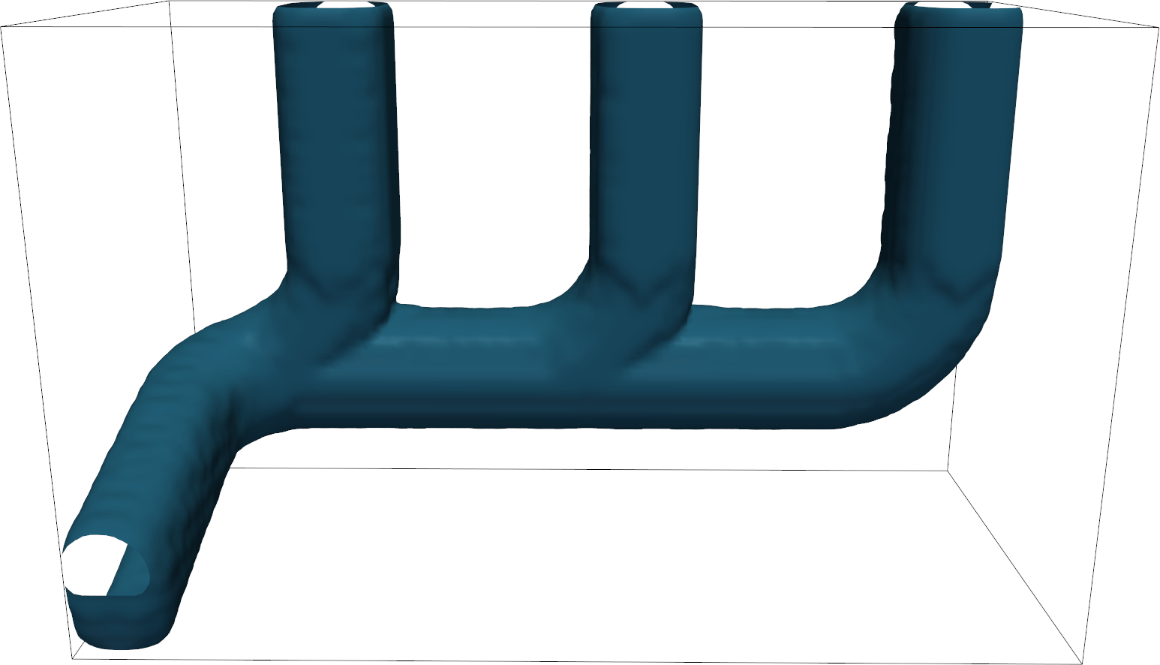
CFD Simulations
Brambilla et al.
Notes:
Talk about flow vis
Starting point: CFD simulation
Exhaust manifold with 3 inlets and 1 outlet, only the central inlet is currently active

Slide 3
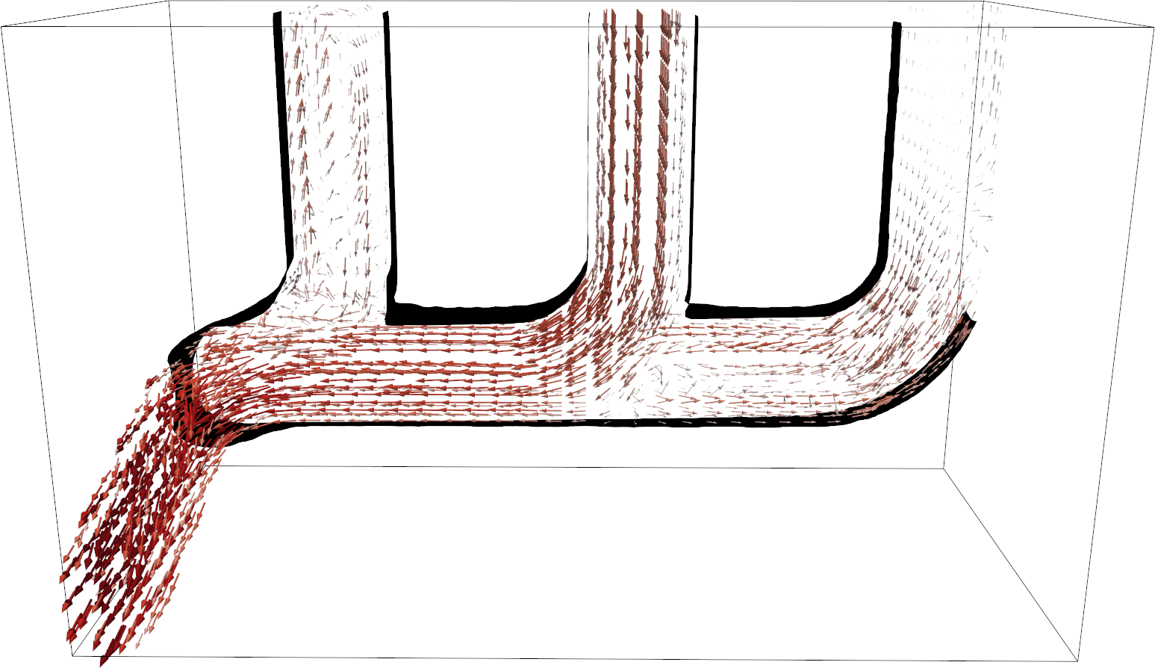
Velocity
Brambilla et al.
Notes:
Simulation produce a velocity vector fields
Instantaneous motion of fluid’s particles (infinitesimally small)
Velocity alone cannot capture the overall complexity of the flow behavior
Domain experts often resort to derived attributes for analysis

Slide 4

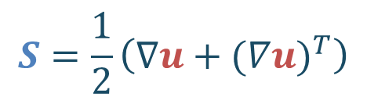
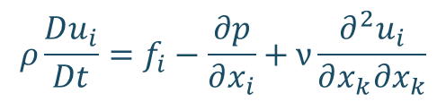


Flow aspects
$$ρ\frac{Du_{i}}{Dt}=f_{i}−\frac{∂p}{∂x_{i}}+ν\frac{∂^{2}u_{i}}{∂x_{k}∂x_{k}}$$
Velocity (motion)
Rate of strain (deformation)
Vorticity (rotation)
$$u\left(x, t\right)$$
$$S=\frac{1}{2}\left(∇u+{(∇u)}^{T}\right)$$
$$ω=∇×u$$
Brambilla et al.
Notes:
All these attributes are connected
There are known relationships between them. E.g., the vorticity transport equation
It is important to look at these attributes simultaneously in order to grasp their relationships

Slide 5
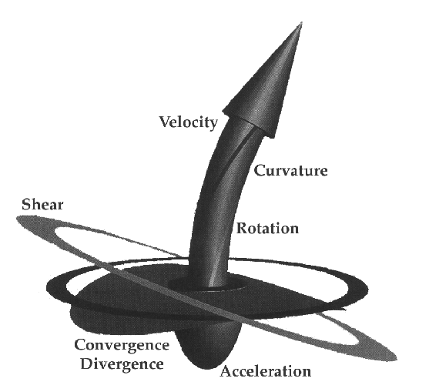
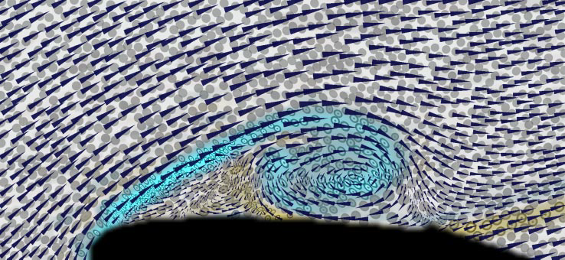
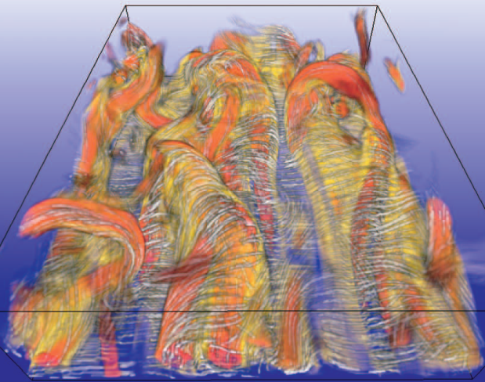
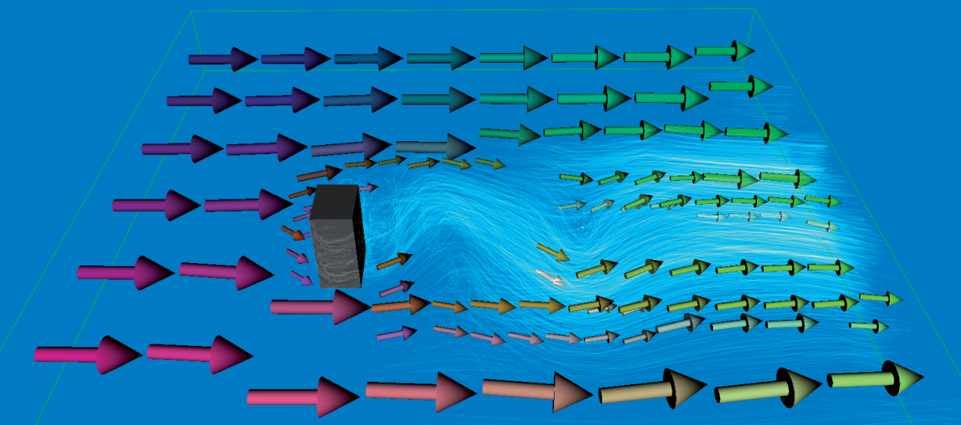
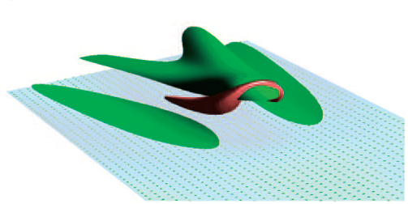
Related work
De Leew and van Wick ‘93
Kirby et al. ‘99
Helgeland et al. ‘07
Bürger et al. ‘08
Schafhitzel et al. ‘11
Brambilla et al.
Notes:
Investigated alone OR multivariate visualization

Slide 6
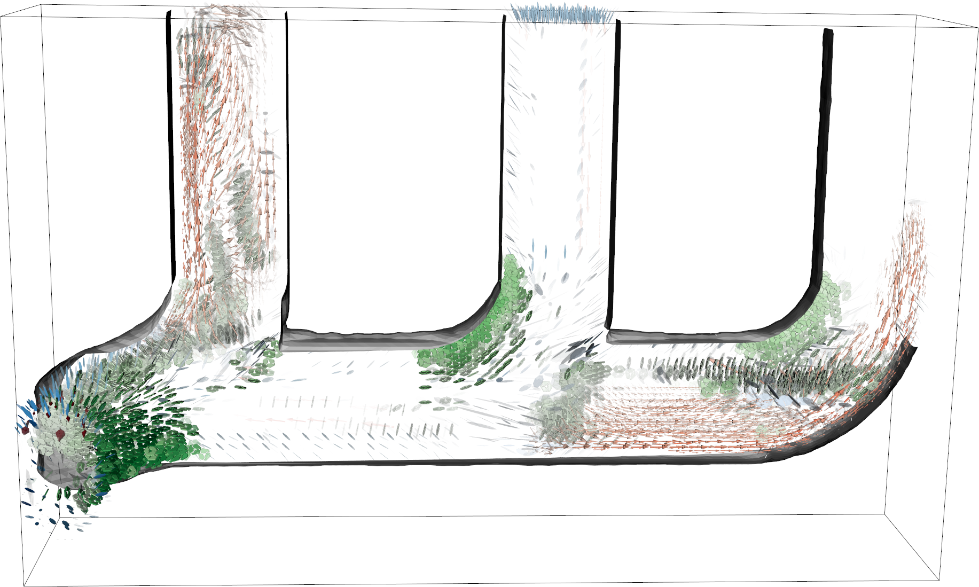
Integrated Multi-aspect Vis
Brambilla et al.

Slide 7
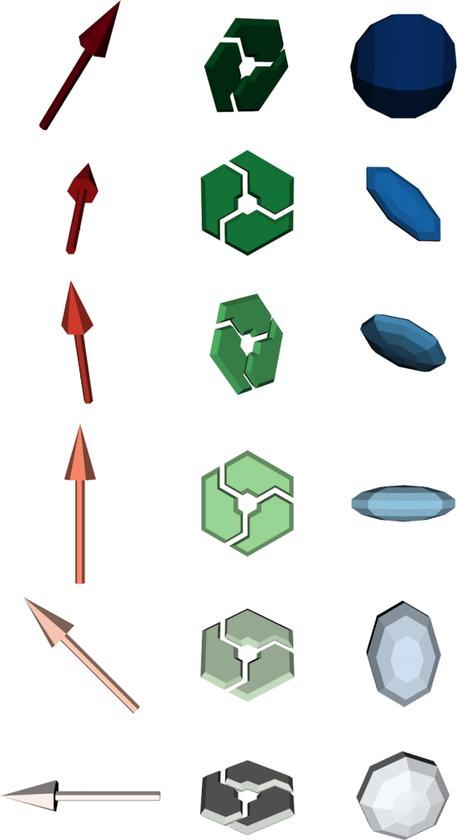
Requirements
Visual representation
  Convey local information
  Handle vector and tensor data
Glyph
  Color -> magnitude
  Geometry -> direction
Manage visibility issues
  Focus + Context visualization
  Exploit data coherency
Velocity magnitude
min max
Vorticity magnitude
min max
Rate of Strain magnitude
min max
Brambilla et al.

Slide 8
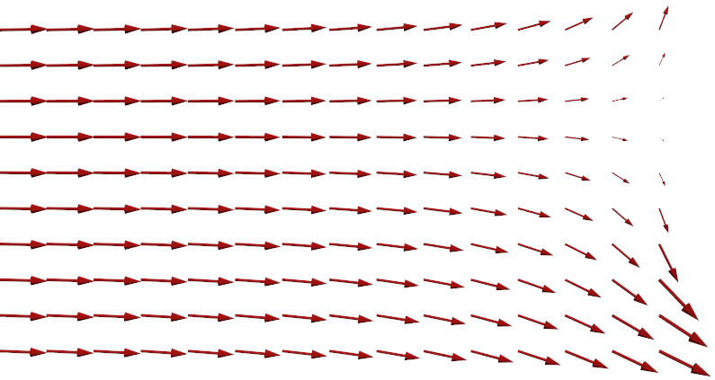
Multiple Focus + Context
Different flow aspects can be more or less relevant
  Swirling motion in a constant laminar flow?
The relevance of an attribute can vary over the domain
Multiple relevance measures
Brambilla et al.

Slide 9
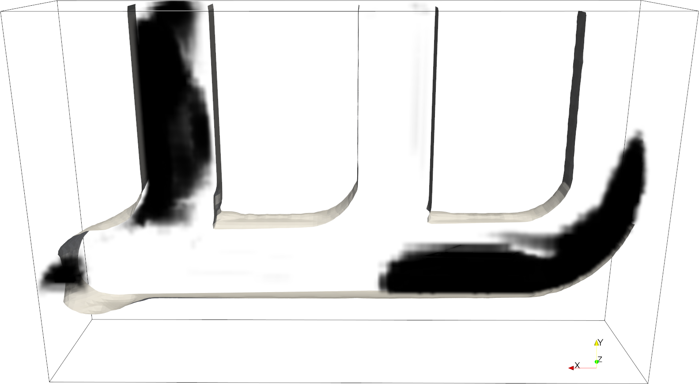
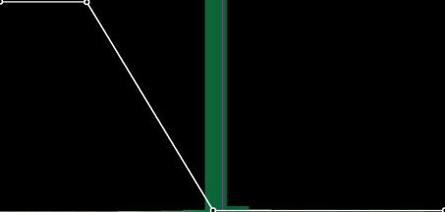
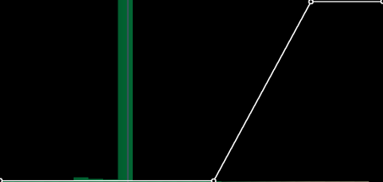
Relevance measures
For each attribute a
  Define a set of potential locations P_{a}
  Define relevance_{a}: P_{a} -> [0, 1]
Relevance measures are user defined
1
relevance
0
1
0
relevance
u_{x}
u_{y}
min max min max
Brambilla et al.

Slide 10
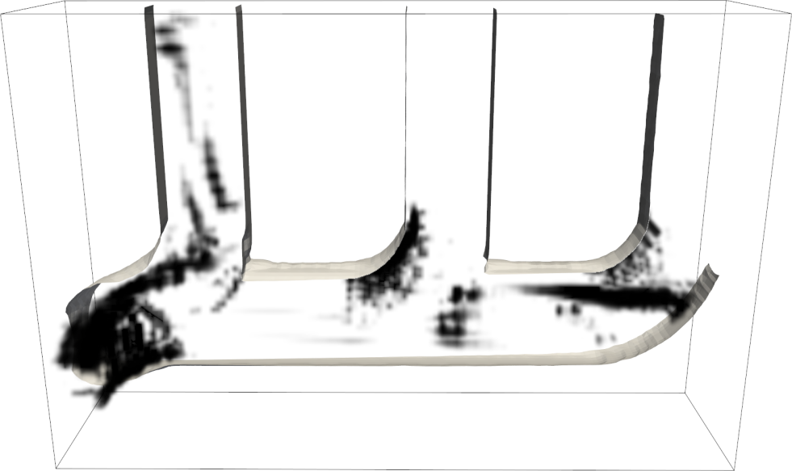
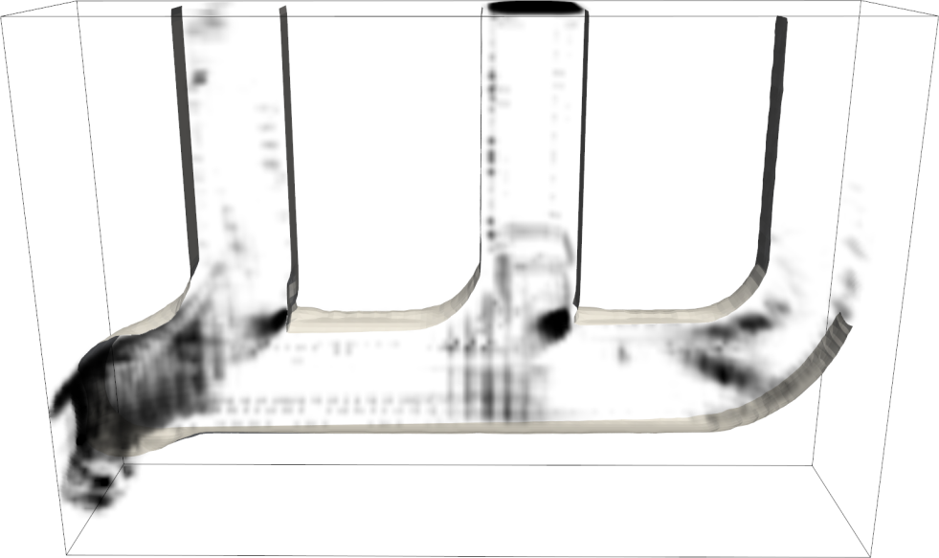
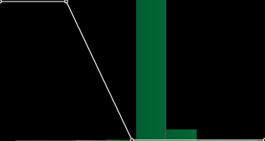
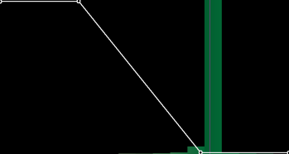
Relevance measures
For each attribute a
  Define a set of potential locations P_{a}
  Define relevance_{a}: P_{a} -> [0, 1]
Relevance measures are user defined
Flow feature detectors can capture physical aspects
  Hunt’s Q / λ₂ / Haimes and Kenwright
1
relevance
0
1
0
relevance
1
0
1
0
relevance
relevance
u_{x}
u_{y}
λ₂
Q
min max min max
Brambilla et al.
min max
min max

Slide 11
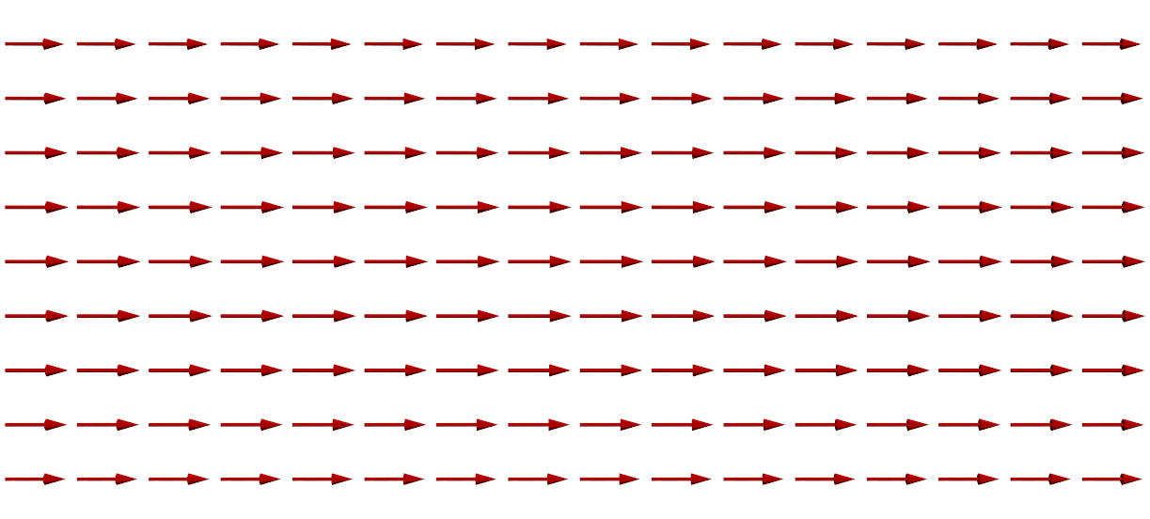

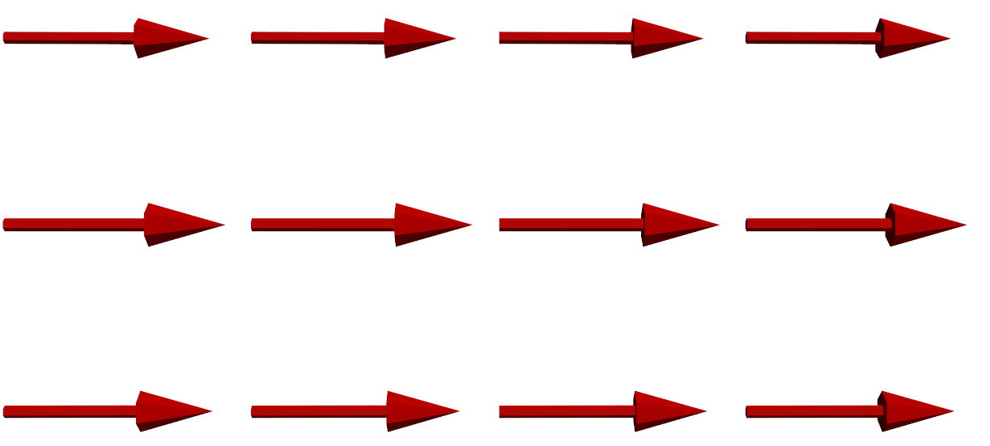
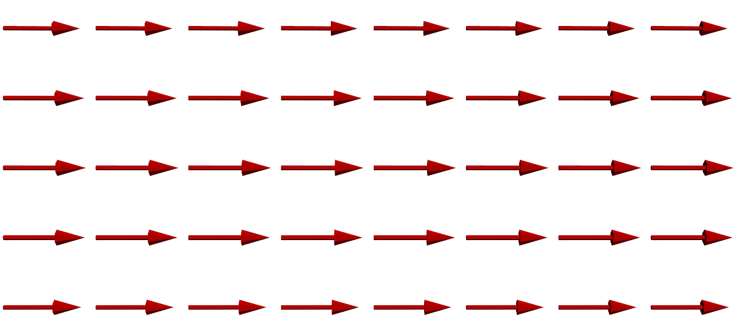
Coherency and Visual Redundancy
Information can be replicated over many samples
Visualize that information only once!
Brambilla et al.

Slide 12
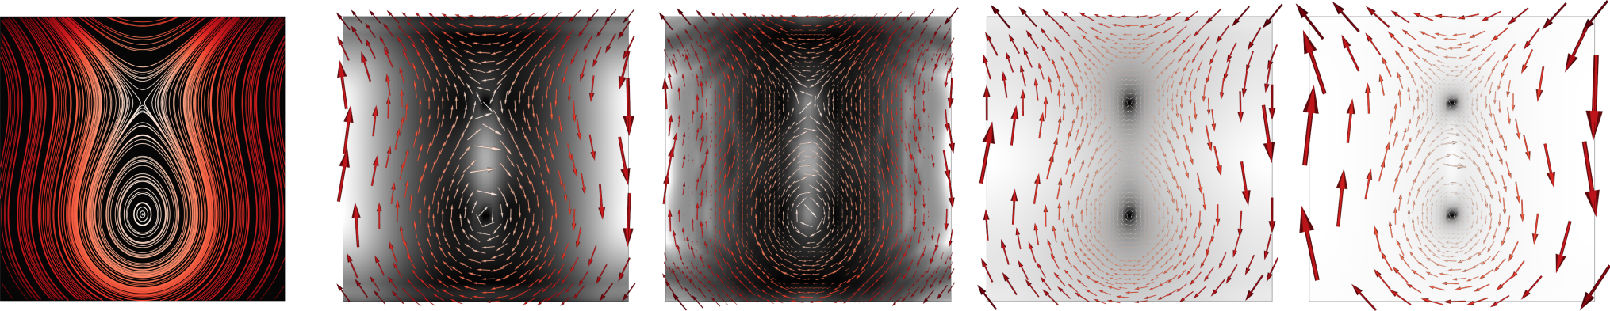
Coherency measures
A coherency measure encodes the degree of redundancy of a set of data samples
For each attribute a, coherency_{a}: P(P_{a}) -> R⁺
Specified by the user
  4 measures implemented in our system
  More measures can be easily added
  Similar overall behaviour, but small differences
test dataset 2nd moment entropy c_diff_{v} c_dot_{v}
Brambilla et al.
Notes:
No coherency measure outperformed the other ones
Example: 5 cell radius, arrow size proportional to coherency
Coherency val = 0 means → equal samples
Higher values → incoherent samples

Slide 13
Visualization strategy
Glyph placement algorithm:
for each attribute a
.. γ_{a} = coherency threshold
.. build(P_{a})
.. sort(P_{a}, relevance_{a})
.. for p in P_{a}
.. .. A_{p} = sphere around p
.. .. while coherency_{a}(A_{p}) < γ_{a}
.. .. .. increase radius of A_{p}
.. .. place a glyph in p
.. .. P_{a} = P_{a} - A_{p}
Brambilla et al.

Slide 14
Visualization strategy
Glyph placement algorithm:
for each attribute a
.. γ_{a} = coherency threshold
.. build(P_{a})
.. sort(P_{a}, relevance_{a})
.. for p in P_{a}
.. .. A_{p} = sphere around p
.. .. while coherency_{a}(A_{p}) < γ_{a}
.. .. .. increase radius of A_{p}
.. .. place a glyph in p
.. .. P_{a} = P_{a} - A_{p}
P_{a}
Brambilla et al.

Slide 15
Visualization strategy
Glyph placement algorithm:
for each attribute a
.. γ_{a} = coherency threshold
.. build(P_{a})
.. sort(P_{a}, relevance_{a})
.. for p in P_{a}
.. .. A_{p} = sphere around p
.. .. while coherency_{a}(A_{p}) < γ_{a}
.. .. .. increase radius of A_{p}
.. .. place a glyph in p
.. .. P_{a} = P_{a} - A_{p}
P_{a}
Brambilla et al.

Slide 16
Visualization strategy
Glyph placement algorithm:
for each attribute a
.. γ_{a} = coherency threshold
.. build(P_{a})
.. sort(P_{a}, relevance_{a})
.. for p in P_{a}
.. .. A_{p} = sphere around p
.. .. while coherency_{a}(A_{p}) < γ_{a}
.. .. .. increase radius of A_{p}
.. .. place a glyph in p
.. .. P_{a} = P_{a} - A_{p}
P_{a}
A_{p}
Brambilla et al.

Slide 17
Visualization strategy
Glyph placement algorithm:
for each attribute a
.. γ_{a} = coherency threshold
.. build(P_{a})
.. sort(P_{a}, relevance_{a})
.. for p in P_{a}
.. .. A_{p} = sphere around p
.. .. while coherency_{a}(A_{p}) < γ_{a}
.. .. .. increase radius of A_{p}
.. .. place a glyph in p
.. .. P_{a} = P_{a} - A_{p}
P_{a}
A_{p}
Brambilla et al.

Slide 18
Visualization strategy
Glyph placement algorithm:
for each attribute a
.. γ_{a} = coherency threshold
.. build(P_{a})
.. sort(P_{a}, relevance_{a})
.. for p in P_{a}
.. .. A_{p} = sphere around p
.. .. while coherency_{a}(A_{p}) < γ_{a}
.. .. .. increase radius of A_{p}
.. .. place a glyph in p
.. .. P_{a} = P_{a} - A_{p}
P_{a}
A_{p}
Brambilla et al.

Slide 19
Visualization strategy
Glyph placement algorithm:
for each attribute a
.. γ_{a} = coherency threshold
.. build(P_{a})
.. sort(P_{a}, relevance_{a})
.. for p in P_{a}
.. .. A_{p} = sphere around p
.. .. while coherency_{a}(A_{p}) < γ_{a}
.. .. .. increase radius of A_{p}
.. .. place a glyph in p
.. .. P_{a} = P_{a} - A_{p}
P_{a}
A_{p}
Brambilla et al.

Slide 20
Visualization strategy
Glyph placement algorithm:
for each attribute a
.. γ_{a} = coherency threshold
.. build(P_{a})
.. sort(P_{a}, relevance_{a})
.. for p in P_{a}
.. .. A_{p} = sphere around p
.. .. while coherency_{a}(A_{p}) < γ_{a}
.. .. .. increase radius of A_{p}
.. .. place a glyph in p
.. .. P_{a} = P_{a} - A_{p}
P_{a}
A_{p}
The radius of A_{p} is mapped to size
The relevance of p is mapped to opacity
Brambilla et al.

Slide 21
Visualization strategy
Glyph placement algorithm:
for each attribute a
.. γ_{a} = coherency threshold
.. build(P_{a})
.. sort(P_{a}, relevance_{a})
.. for p in P_{a}
.. .. A_{p} = sphere around p
.. .. while coherency_{a}(A_{p}) < γ_{a}
.. .. .. increase radius of A_{p}
.. .. place a glyph in p
.. .. P_{a} = P_{a} - A_{p}
P_{a}
The radius of A_{p} is mapped to size
The relevance of p is mapped to opacity
Brambilla et al.

Slide 22
Visualization strategy
Glyph placement algorithm:
for each attribute a
.. γ_{a} = coherency threshold
.. build(P_{a})
.. sort(P_{a}, relevance_{a})
.. for p in P_{a}
.. .. A_{p} = sphere around p
.. .. while coherency_{a}(A_{p}) < γ_{a}
.. .. .. increase radius of A_{p}
.. .. place a glyph in p
.. .. P_{a} = P_{a} - A_{p}
P_{a}
Repeat until all the points have been processed
Repeat for every attribute of interest
Brambilla et al.

Slide 23
Integrated Multi-aspect Vis
Brambilla et al.

Slide 24

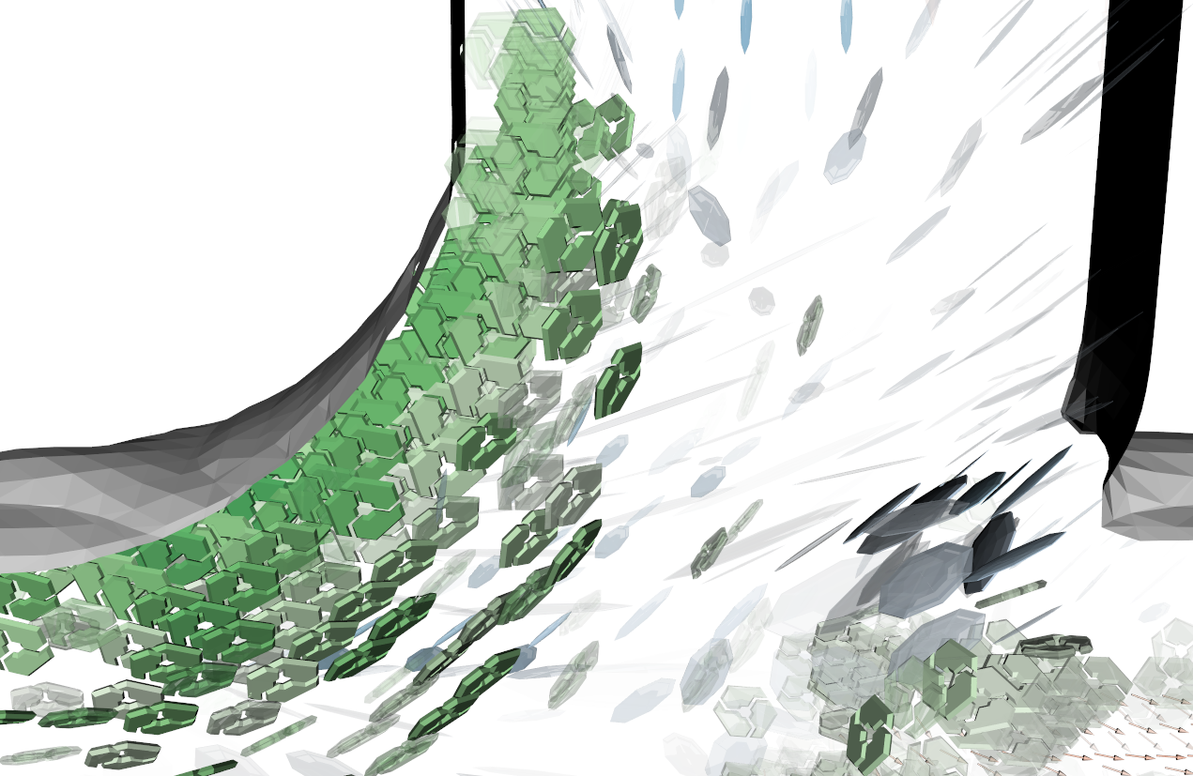
Integrated Multi-aspect Vis
Brambilla et al.

Slide 25
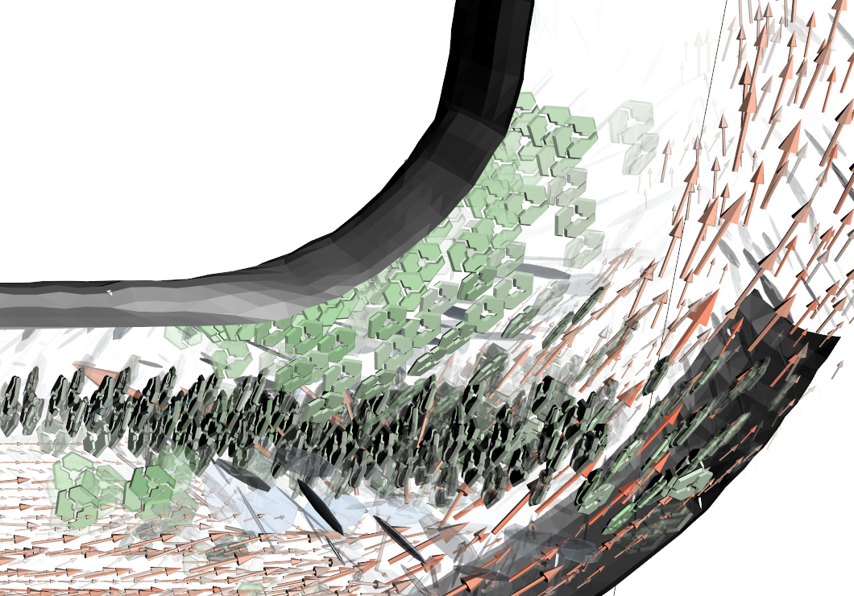
Integrated Multi-aspect Vis
Brambilla et al.

Slide 26
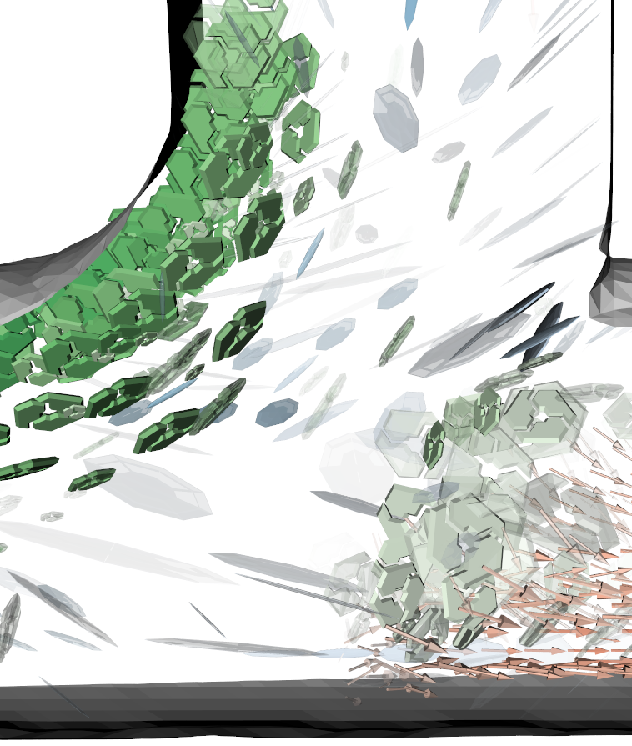
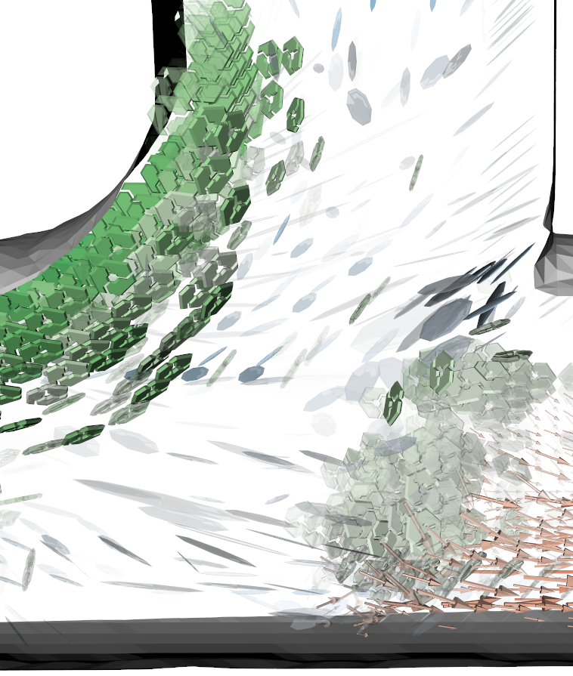
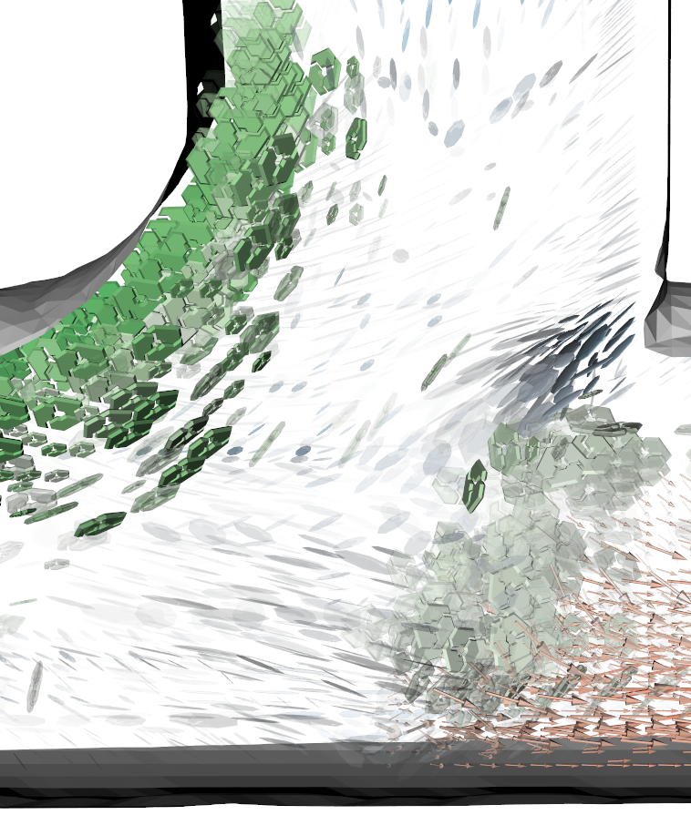
Parameter settings
Relevance corresponds to user’s interest
Coherency threshold
  Initially set to 10% of maximal coherency value
  Can be interactively adjusted
high thresh. mid thresh. low thresh.
Brambilla et al.

Slide 27
Final remarks
Our visualization strategy
  Presents multiple flow aspects simultaneously
  Handles visibility issues through smart placement
  Can be easily extended
Future work
  Streamlets as a new representation
  Coherency measure based on tensor invariants
  Adapt the strategy to integral curves
  Extension to time-dependent datasets
Brambilla et al.

Slide 28
Thanks for your attention!
Brambilla et al.

Slide 29
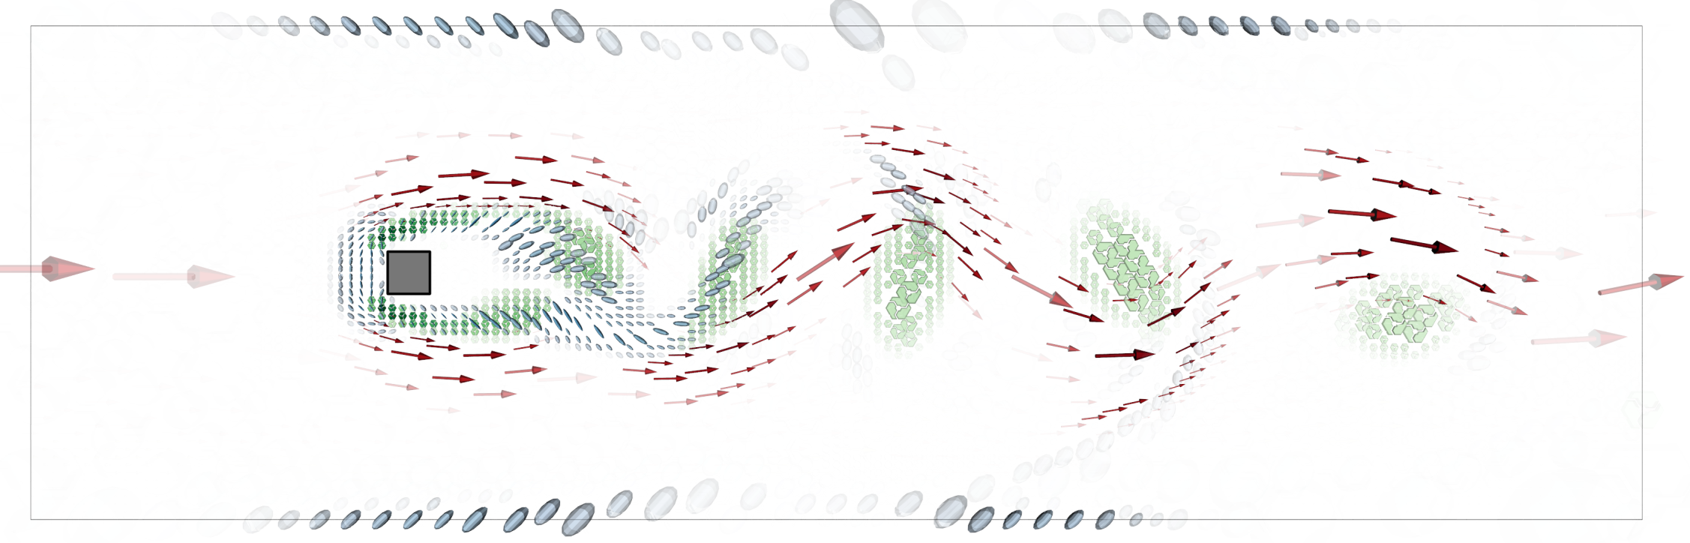
Square Cylinder
Brambilla et al.

Slide 30
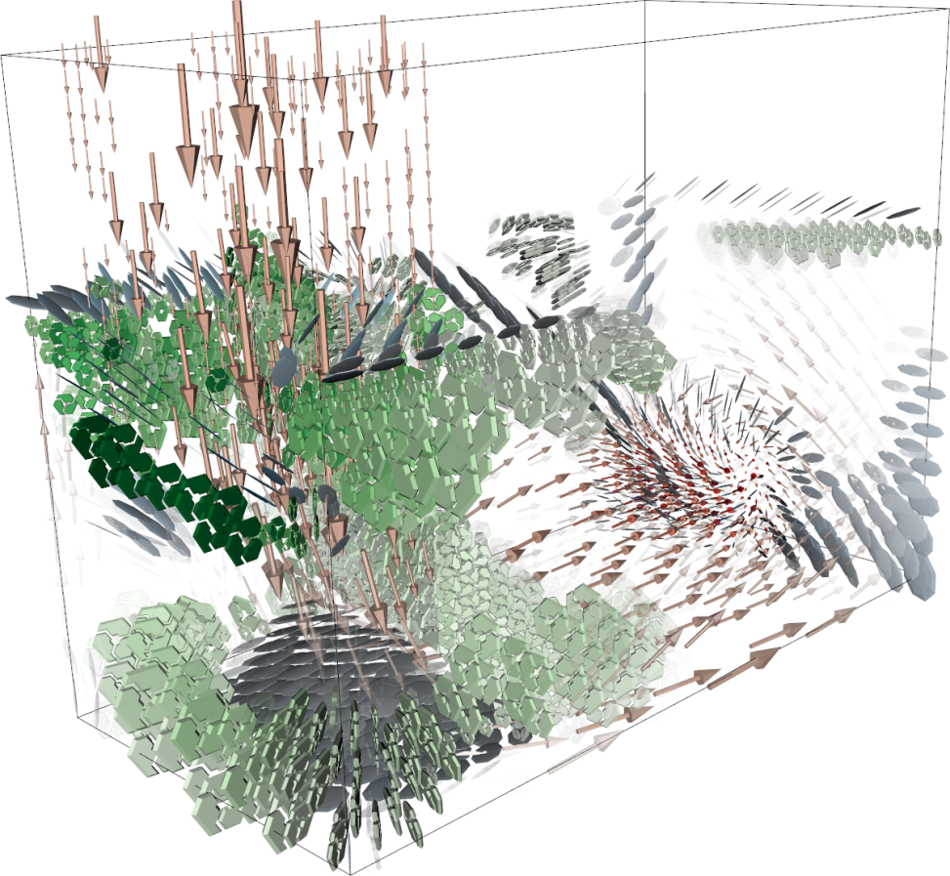
Flow in a Box
Brambilla et al.

Slide 31
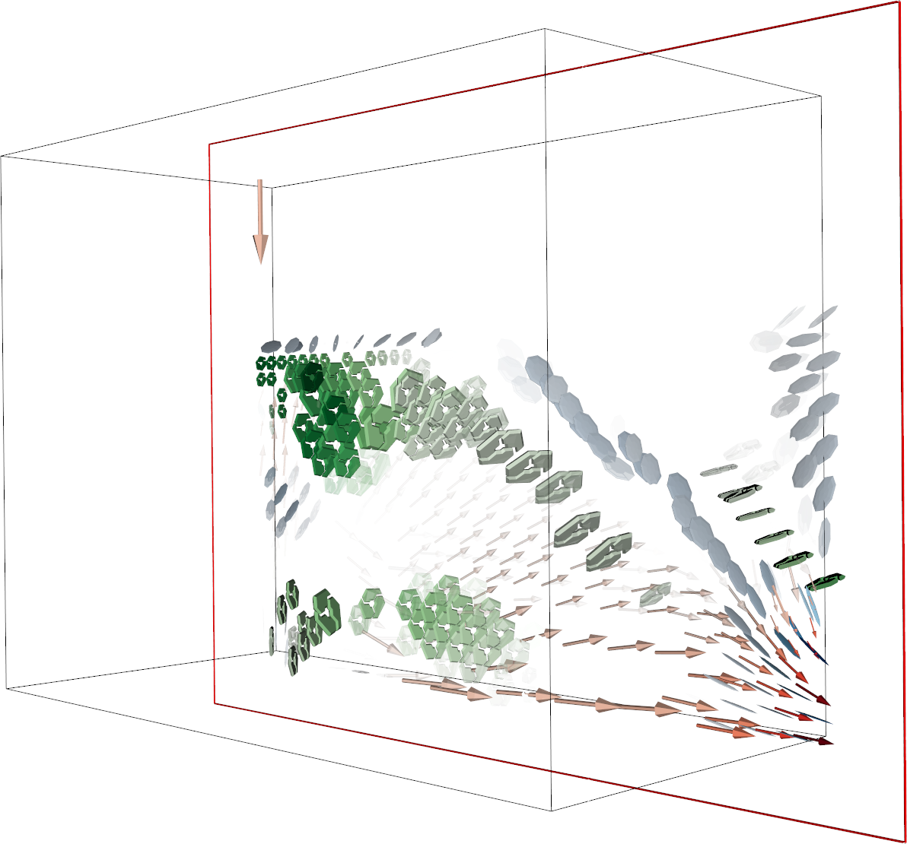
Flow in a Box (pruned)
Brambilla et al.

Slide 32
Integrated Multi-aspect Visualization of 3D Fluid Flows
Andrea Brambilla¹
Øyvind Andreassen^{2,3}
Helwig Hauser¹
¹ University of Bergen, Norway
² Norwegian Defence Research Establishment, Norway
³ University Graduate Center at Kjeller, Norway

Slide 33
Exhaust Manifold
Brambilla et al.

Slide 34
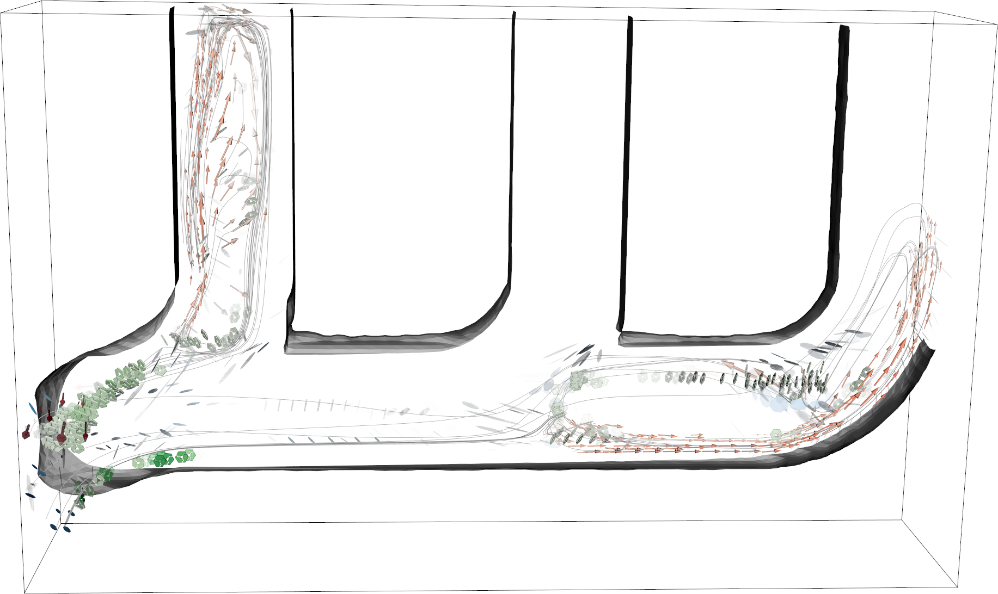
Exhaust Manifold (pruned)
Brambilla et al.

Slide 35
Thanks for your attention!
Brambilla et al.

Slide 36

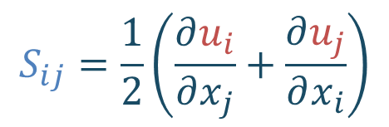
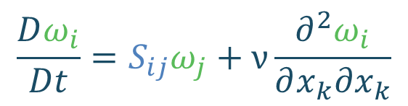

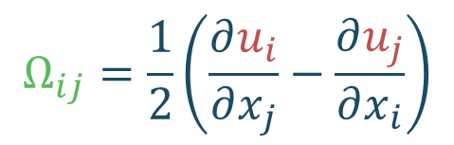
Attributes of interest
$$ρ\frac{Du_{i}}{Dt}=f_{i}−\frac{∂p}{∂x_{i}}+ν\frac{∂^{2}u_{i}}{∂x_{k}∂x_{k}}$$
$$u_{i}\left(x_{j}, t\right)$$
Velocity vector field
Rate of strain tensor
Vorticity tensor
Vorticity vector
$$S_{ij}=\frac{1}{2}\left(\frac{∂u_{i}}{∂x_{j}}+\frac{∂u_{j}}{∂x_{i}}\right)$$
$$Ω_{ij}=\frac{1}{2}\left(\frac{∂u_{i}}{∂x_{j}}−\frac{∂u_{j}}{∂x_{i}}\right)$$
$$ω_{ij}={−ε}_{ijk}Ω_{jk}$$
$$\frac{Dω_{i}}{Dt}=S_{ij}ω_{j}+ν\frac{∂^{2}ω_{i}}{∂x_{k}∂x_{k}}$$
Vorticity transport equation
Brambilla et al.
Notes:
All these attributes are connected
There are known relationships between them. E.g., the vorticity transport equation
It is important to look at these attributes simultaneously in order to grasp their relationships

Slide 37
Performance
Performance
  Relevance is pre-cumputed
  Coherency computation depends on
    Dataset size and number of relevant points
    Actual data coherency
    Exhaust Manifold (133x81x31) -> 0.128 sec (2.8GHz CPU)
  Bottleneck is the geometry generation
    Exhaust Manifold -> 0.470 sec / 1.037 sec (depth sort)
    But GPU implementation feasible!
Brambilla et al.

Slide 38
Streamline-based Pruning
Brambilla et al.

Slide 39

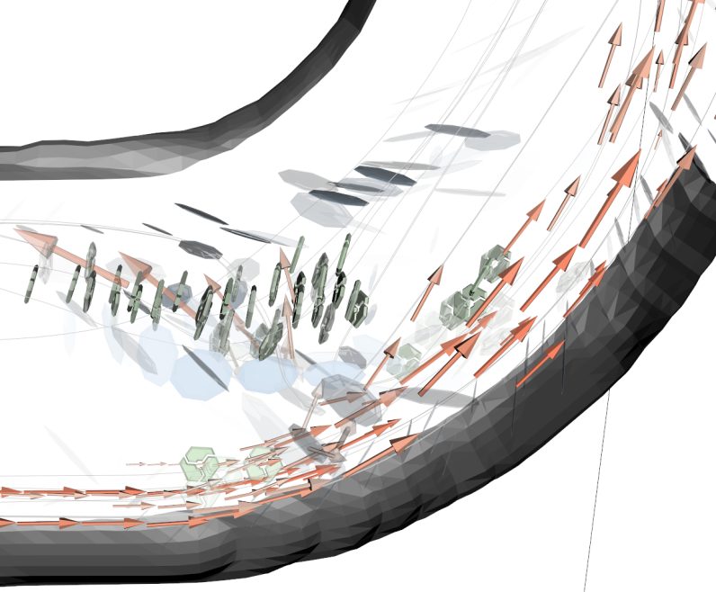
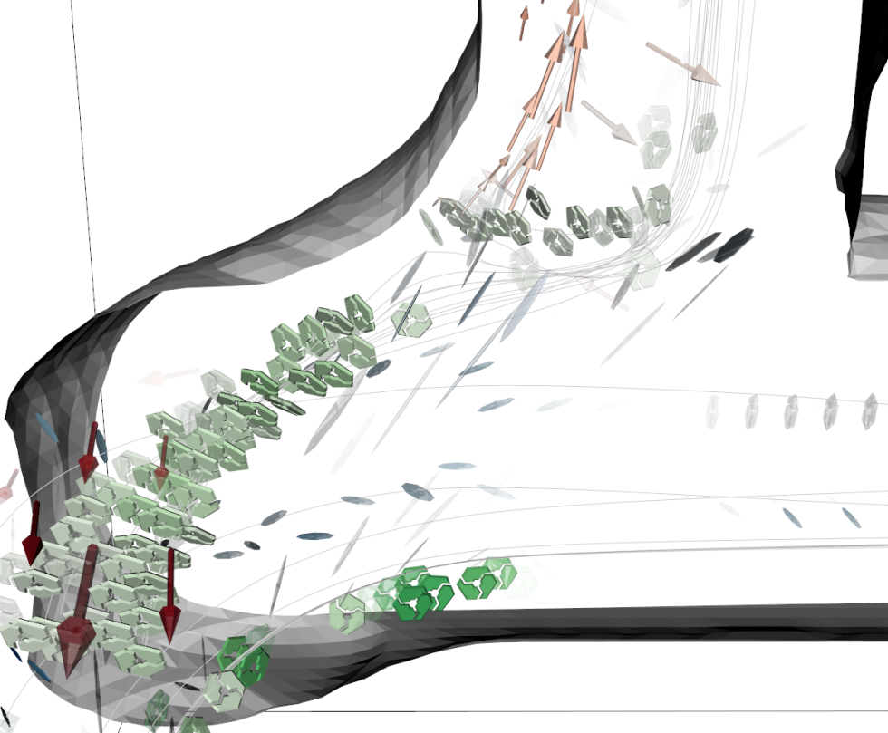
Streamline-based Pruning
Brambilla et al.

Slide 40
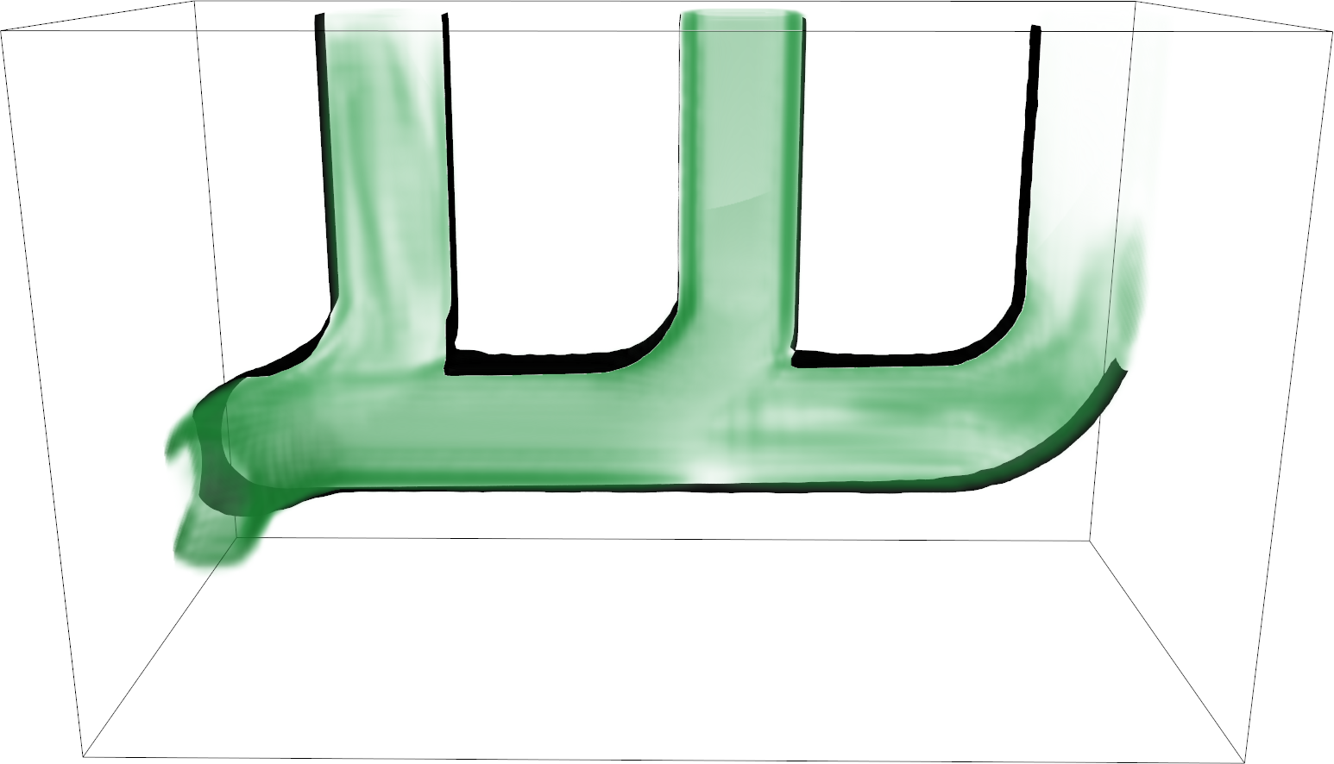
Vorticity
Brambilla et al.
Notes:
Vorticity represent the instantaneous rotation of fluid’s particles

Slide 41
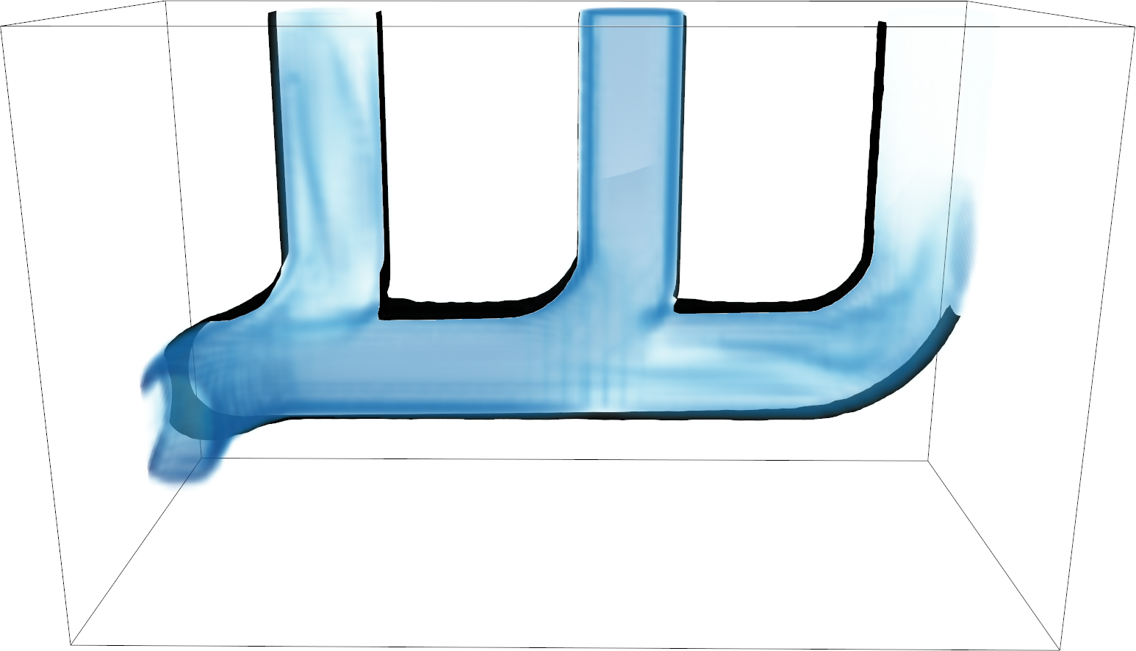
Rate of Strain
Brambilla et al.
Notes:
Rate of strain represent the instantaneous deformation of an infinitesimally small fluid’s volume

